Slide 1
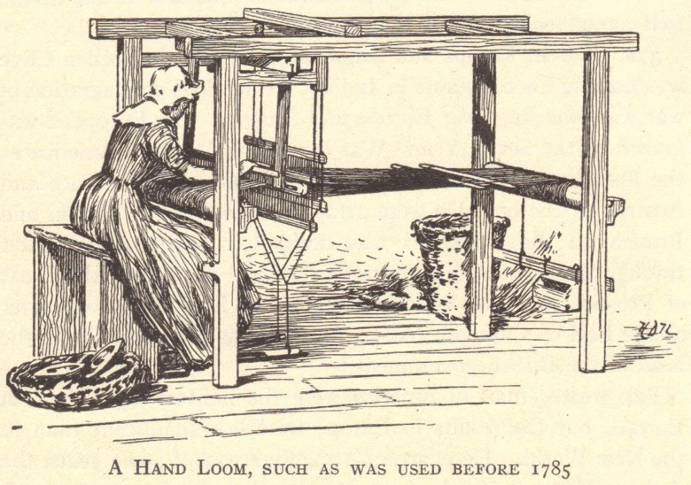
The Industrial Revolution
© Student Handouts, Inc.

Slide 2
Key Terms: Industrial Revolution, factors of production, factory system, labor union, mass production, interchangeable parts, assembly line, socialism, Karl Marx, communism, standard of living, Henry Ford, Bessemer Process
Guiding Questions: Why did the IR begin in England? How did the IR change daily life (work and at home)?What are some of the innovations during this time? How did society change?
Main Idea: The Industrial Revolution is a time of great change that spurred economic, political, and social movements, globally.

Slide 3
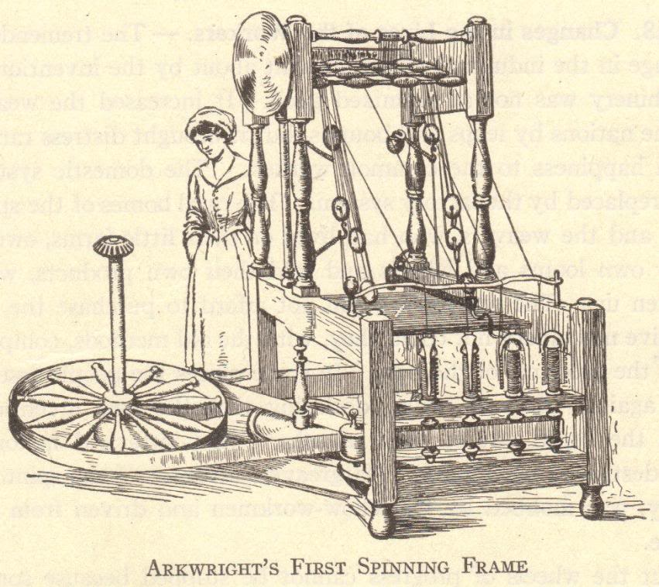
The First Industrial Revolution

Slide 4
Historical Significance of the Industrial Revolution
An ancient Greek or Roman would have been just as comfortable in Europe in 1700 because daily life was not much different – agriculture and technology were not much changed in 2000+ years
The Industrial Revolution changed human life drastically
More was created in the last 250+ years than in the previous 2500+ years of known human history

Slide 5
What was the Industrial Revolution?
The Industrial Revolution was a fundamental change in the way goods were produced, from human labor to machines
The more efficient means of production and subsequent higher levels of production triggered far-reaching changes to industrialized societies

Slide 6
The Industrial Revolution
New energy sources were developed to power the new machinery – water, steam, electricity, oil (gas, kerosene)
Increased use of metals and minerals
Aluminum, coal, copper, iron, etc.

Slide 7
The Industrial Revolution
Transportation improved
Ships
Wooden ships → Iron ships → Steel ships
Wind-powered sails → Steam-powered boilers
Trains
Automobiles
Communication improved
Telegraph
Telephone
Radio

Slide 8
Developments
Mass production of goods
Development of factory system of production
Rural-to-urban migration
Development of capitalism
Development and growth of new socio-economic classes
Commitment developing technologies

Slide 9
Background of the Industrial Revolution
Commercial Revolution (Exploration and Colonization)
15th, 16th, and 17th centuries Europeans expanded their power through colonies in the Americas and Asia
Increased trade and commerce
Guild system could not meet the demands.
Scientific Revolution
17th and 18th centuries
Discoveries of Boyle, Lavoisier, Newton, etc.
Intellectual Revolution (Enlightenment)
17th and 18th centuries
Writings of Locke, Voltaire, etc.

Slide 11
Why the Industrial Revolution Started in England
No concrete start date; Marked by gradual, slow changes; after 1750 – these changes were noticeable first in England
Capital for investing in the means of production
Colonies and Markets for manufactured goods
Raw materials for production
Workers
Merchant marine
Geography

Slide 12
“Necessity Is the Mother of Invention”
Spinning machine
Need to speed up weaving
Power loom created
Textiles-First industry to be industrialized

Slide 13
“Necessity Is the Mother of Invention”
Power loom
Increased demand for raw cotton
Invention of the cotton gin

Slide 14
“Necessity Is the Mother of Invention”
Cotton gin
Demands for stronger iron
Improvements in iron smelting and the development of steel (Bessemer process)

Slide 15
Development of Steam Engines
Early water power involved mills built over fast-moving streams and rivers
Not enough rivers to provide the power needed to meet growing demand
Rivers and streams might be far removed from raw materials, workers, and markets
Mother Nature-Rivers are prone to flooding and drying

Slide 16
Steam Engines
By 1800, steam engines were replacing water wheels as sources of power for factories
Factories relocated near raw materials, workers, and ports
Cities grew around the factories built near central England’s coal and iron mines
Manchester, Liverpool

Slide 17
Transportation Revolution
Robert Fulton (American)
Steamboat (1807)
Sped water transportation
Thomas Telford and John McAdam (British)
Macadamized roads (1810-1830)
George Stephenson (English)
Locomotive (1825)
Improved roads
Fast land transport of people and goods
Gottlieb Daimler (German)
Gasoline engine (1885)
Led to the invention of the automobile
Rudolf Diesel (German)
Diesel engine (1892)
Cheaper fuel
Orville and Wilbur Wright (American)
Airplane (1903)
Air transport

Slide 18
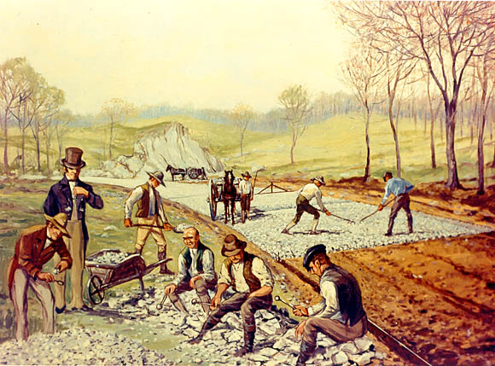

Slide 19
Communications Revolution
Samuel F.B. Morse (American)
Telegraph (1844)
Rapid communication across continents
Alexander Graham Bell (American)
Telephone (1876)
Human speech heard across continents
Cyrus W. Field (American)
Atlantic cable (1866)
United States and Europe connected by cable
Guglielmo Marconi (Italian)
Wireless telegraph, an early form of the radio (1895)
No wires needed for sending messages
Lee de Forest (American)
Radio tube (1907)
Radio broadcasts could be sent around the world
Vladimir Zworykin (American)
Television (1925)
Simultaneous audio and visual broadcast

Slide 20
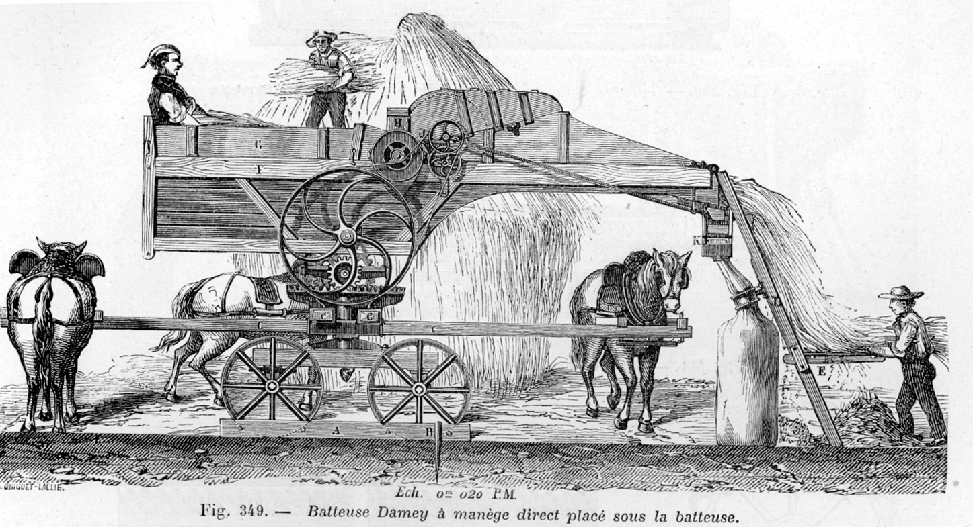
The Agricultural Revolution

Slide 21
The Agricultural Revolution
Agricultural methods had not changed much since the Middle Ages
Tools – hoe, sickle, wooden plow
Three-field system – farmers left 1/3 of the land fallow each year to restore fertility to the soil
Open-field system – unfenced farms with few improvements made to the land
No significant surplus – only enough food was made to feed the population

Slide 22
Agriculture and Industry
The Industrial Revolution brought machinery to farms
The use of farm machinery meant that fewer farm workers were needed
Displaced farm workers moved to the cities to find work in factories
This is called rural-to-urban migration
Growing populations in urban cities required farmers to grow more crops
Food to eat
Raw materials (like cotton) for textile factories

Slide 23
Agricultural Innovators
Jethro Tull (English)
Seed drill: Planted seeds in straight rows as opposed to scattering them over a field
Horse-drawn cultivation: Loosened the soil and eliminated weeds
Lord Townshend (English)
Crop rotation: Ended the three-field system by illustrating how planting different crops in the same field each year kept the soil from becoming exhausted
Robert Bakewell (English)
Stock breeding: First to scientifically breed farm animals for increased production of, and better quality, beef, milk, wool, etc.
Arthur Young (English)
Agricultural writer: Popularized new farming methods and machinery
Justus von Liebig (German)
Fertilizers: Invented fertilizers to enrich exhausted soil, which increased the amount of available farmland

Slide 24
Agricultural Machinery
Eli Whitney – Cotton gin (1793) – Increased cotton production
Cyrus McCormick – Mechanical reaper (1834) – Increased wheat production
Other important inventions: Horse-drawn hay rake, threshing machine, steel plow
Steam engines, gasoline and diesel engines, and electric motors were added to farm machinery as these types of engines were invented.
The Industrial and Agricultural Revolutions complemented one another. Developments and needs in one created developments and needs in the other.

Slide 25
Agricultural Science
Agriculture becomes science. Farmers and governments invested in agricultural research
Established agricultural schools, societies, and experimental stations
Progress in agriculture
Pesticides, stock breeding, new foods, food preservation, new farming techniques and irrigation methods, frozen foods
Result
Today, in the industrialized world, much more food is grown by far fewer farmers than was grown 200 years ago (or is grown today in the non-industrialized world)
Notes:
Notes: A good topic of discussion might focus on the modern taste for organic foods which do not emphasize technology. Question: What methods and technologies of the Agricultural Revolution do organic farmers utilize? How might our lives be different if we lived 200 years ago, when food was costlier and could not be easily preserved? Another point of discussion could focus on the differences in agricultural production between the industrialized and non-industrialized world.

Slide 26
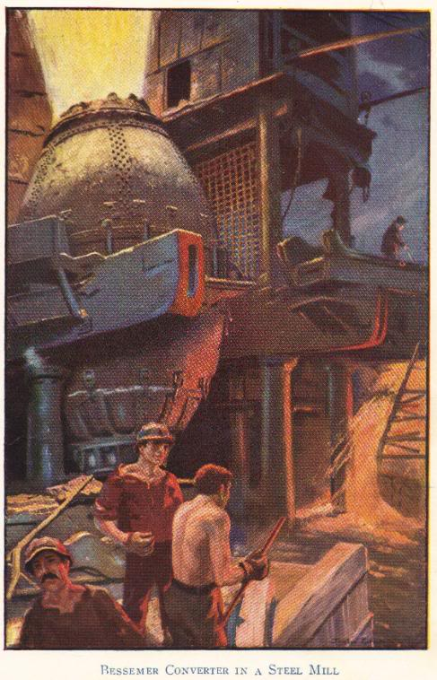
The Second Industrial Revolution

Slide 27
The First and Second Industrial Revolutions
The first, or old, Industrial Revolution took place between about 1750 and 1870
Took place in England, the United States, Belgium, and France
Saw fundamental changes in agriculture, the development of factories, and rural-to-urban migration
The second Industrial Revolution took place between about 1870 and 1960
Saw the spread of the Industrial Revolution to places such as Germany, Japan, and Russia
Electricity became the primary source of power for factories, farms, and homes
Mass production, particularly of consumer goods
Use of electrical power saw electronics enter the marketplace (electric lights, radios, fans, television sets)

Slide 28
Transportation
Railroads
Industrialized nations first laid track in their own countries, then in their colonies and other areas under their political influence
Russia – Trans-Siberian railroad (1891-1905)
Germany – Berlin-to-Baghdad railroad across Europe to the Middle East
Great Britain – Cape-to-Cairo railroad vertically across Africa
Canals
Suez Canal (1869) – provided access to the Indian Ocean from the Mediterranean Sea without the need to sail around Africa
Kiel Canal (1896) – North Sea connected to the Baltic Sea
Panama Canal (1914) – provided access from one side of the Americas to the other without the need to sail around the tip of South America

Slide 29
Transportation
Automobiles
Charles Goodyear – vulcanized rubber, 1839
Gottlieb Daimler – gasoline engine, 1885
Henry Ford – assembly line, 1908-1915
Airplanes
Orville and Wilbur Wright – airplane, 1903
Charles Lindbergh – first non-stop flight across the Atlantic, 1927
20th-century – growth of commercial aviation

Slide 30
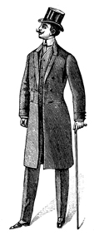
The Results of the Industrial Revolution

Slide 31
Results of the Industrial Revolution
Economic Changes
Expansion of world trade
Factory system
Political Changes
Decline of landed aristocracy
Social Changes
Development and growth of cities
Science and research stimulated
Industrial capitalism
Unemployment
Growth and expansion of democracy
Rise to power of businesspeople
Increased government involvement in society
Nationalism and imperialism stimulated
Increased power of industrialized nations
Improved status and earning power of women
Increase in leisure time
Population increases
Problems – economic insecurity, increased deadliness of war, urban slums, etc.
Increased standard of living
Mass production of goods

Slide 32
Economic Changes: Expansion of World Trade
Increased production meant that industrialized nations produced more than could be consumed internally
Sought new foreign markets
Bought many raw materials from foreign markets
New iron, steam-powered ships, along with other technological advances, made international trade (and travel) cheaper, safer, and more efficient

Slide 33
Economic Changes: Expansion of World Trade – Free Trade and Tariffs
Free trade – trade without barriers or tariffs – was initially used
As nations competed for markets, protective tariffs were put in place to limit foreign competition within an industrialized nation and its colonies
Motivation was to protect businesses in the home country and colonies, but this often meant people in the home country or colonies paid inflated prices for goods
Notes:
Notes: Possible discussion about tariffs vs. free trade. Compare NAFTA and the European Union.

Slide 34
Economic Changes: Factory System Possible Due to Standardized Parts
Before the late 1700s, each part of an item (like a musket) was made individually by a single person, with each part made to fit the whole
Standardized, or interchangeable, parts were created “en masse” to make a lot of duplicate products (such as hundreds of muskets)

Slide 35
Economic Changes: Factory System Perfected , Assembly Line, Mass Production
Developed by Henry Ford between 1908 and 1915
Brought the work to the worker instead of the worker to the work, saving time.
Product moves along a conveyor belt, with each worker contributing labor along the way to create the finished product.
Worker specializes in one part, repetitive.
Manufacture=workers no longer own means of production.
Mass production meant more items were produced at lower costs

Slide 36
Economic Changes: Industrial Capitalism and the Working Class
Pre-Industrial Revolution rural families did not rely solely on wages for sustenance
Owned their own farms or gardens where they raised most of their own food
Made their own clothing
Unemployment was rare
Industrialization destroyed workers’ independence
Workers in cities did not have the means to grow their own food or make their own clothing
Workers relied entirely upon their employers for wages and livelihood. with which they bought everything they needed

Slide 37
Economic Changes: Industrial Capitalism
The financial investments required to run large industries brought about modern capitalism.
Capital – wealth that is used to produce more wealth
Entrepreneur – person who starts a business to make a profit
Capitalist – person who invests his or her money in a business to make a profit
Corporation – company owned by stockholders who have purchased shares of stock
Actual running of the company left to hired managers rather than to the stockholders
As industries grew and small business operations faded into obscurity, the relationship between workers and business owners disintegrated

Slide 38
Economic Changes: Industrial Capitalism’s Problems
Small manufacturers cannot compete with large corporations
Consumers must buy from large corporations
Workers have had to fight for decent wages and working conditions
Large corporations can influence the government!!!

Slide 39
Economic Changes: Increased Standard of Living
Mass production made manufactured goods less expensive, so more people could afford them (Middle Class)
Standard of living wasn’t raised for everyone – factories paid low wages, and many immigrants and rural-to-urban migrants lived poorer lives than their parents and grandparents had lived

Slide 40
Economic Changes: Unemployment
Overproduction
Also called under-consumption
Mass production anticipates demand – if goods don’t sell, a manufacturer produces less and lays off workers
Recession
Overproduction across many industries with widespread lay-offs
Depression
Long-lasting recession
Notes:
Notes: This is a great opportunity to discuss the recession which began in the fall of 2008. Regarding unemployment, this is a chance to bring economics lessons into the classroom, such as the belief among many economists that a 6% unemployment rate can be expected in a strong, healthy, capitalist economy.

Slide 41
Political Changes: Decline of Landed Aristocracy
Before the Industrial Revolution – power was in the hands of the landed aristocracy and monarchs
Landed aristocracy refers to lords, dukes, etc., who owned the land
Although vassalage was gone by the 18th century, the working relationship between lords and peasants remained the same
Wealth was based on agriculture, which meant that those who owned the most land were the wealthiest
Industrial Revolution – factories became more valuable than land
Wealth of the aristocracy dwindled
Growing middle class, with wealth based in industry, wanted more political power

Slide 42
Political Changes: Growth and Expansion of Democracy
The middle class grew during the Industrial Revolution and gain more rights.
The working class effectively began with the Industrial Revolution
The working class fought for rights in the workplace
The working class demanded and earned a voice in government

Slide 43
Political Changes: Increased Government Involvement in Society
Government actions to help workers
Legalization of unions
Established minimum wage
Standards for working conditions
Forms of social security
Government actions to help consumers
Regulation and inspection of goods and foodstuffs
Government actions to help businesses
Laws to stop or limit monopolies
Some governments took control of vital industries

Slide 44
Political Changes: Nationalism and Imperialism Stimulated
Increased production meant an increased need for raw materials
Industrialized nations expanded their colonial empires and spheres of influence in their search for more raw materials
Worldwide scramble for colonies
Fought the peoples in the lands they controlled
Fought one another for colonies and spheres of influence

Slide 45
Social Changes: Development and Growth of Cities
Paris
18th century - 600,000 people
London
18th century – 500,000 people
Circa 1900 – over 6,200,000 in the London urban area
Circa 1900 – over 2,714,000 in the Paris urban area
Circa 2000 – over 11,000,000 in the Paris urban area
Circa 2000 - over 7,100,000 in the London urban area
Rural-to-urban migrants – people who left the countryside to live in cities
A sign of an industrialized nation is that a large proportion of the population lives and works in urban areas

Slide 46
Social Changes: Improved Status and Earning Power of Women
Initially, factory owners hired women and children because they worked for lower wages
This brought many women, otherwise impoverished, to cities to work in factories
Governments limited the work of children and, at times, of women
Women gained economic power and independence
Before industrialization, it was almost impossible for a woman to remain single and live on her own
Factories and urban centers attracted women in large numbers
Women fought for and eventually gained political rights
Notes:
Note: This is a complicated issue. The presence of women and children in factories, doing the same work as men for less pay, was a threat to men. Limiting the employment of women and children brought job security to men. It is easy to fall into the trap of labeling an end to child labor, and equal pay for women, altruistic when these actions benefited men quite a lot.
Note: Women continue to relocate to cities more than men. In New York City, there are approximately 100 adult women for every 85 adult men. A good discussion might focus on why women continue to be attracted to large urban areas.

Slide 47
Social Changes: Increase in Leisure Time
Labor-saving devices invented and produced
Vacuum cleaners
Washing machines
Refrigerators
Entrepreneurs and inventors developed new forms of entertainment
Moving pictures
Amusement parks
Birth of the weekend
Traditionally, Western nations had Sunday (the Christian day of rest) as the only day off from work
Saturday was added (after the struggles of Jewish labor unionists) to accommodate the religious observances of Jewish factory workers (whose Sabbath, or Shabbat, runs from Friday at sundown to Saturday at sundown)

Slide 48
Social Changes: Population Increases
Agricultural Revolution
Increased food production
Lower food prices
People ate more
More healthy babies were born
Population skyrocketed
Europe
1750 – 144,000,000
1900 – 325,000,000
England
1750 - 11,000,000
1900 - 30,000,000
Many people immigrated to industrialized countries
Numerous nationalities to the United States
Irish to Manchester and Liverpool in England
Population growth in industrialized nations required growing even more food

Slide 49
Social Changes: Problems
Monotony of assembly lines and factory life
Loss of craftsmanship in manufactured goods
War became more deadly as weapons became more technologically advanced and were mass produced
Economic insecurity – workers relied entirely on their jobs for sustenance

Slide 50
Social Changes: Science and Research Stimulated
Scientific and technological discoveries became profitable instead of simply beneficial
Companies and governments were willing to invest in research and development
Patent law
Came into its modern form under England’s Queen Anne (reigned 1702-1714)
Inventors have the exclusive right to produce their new inventions for a period of time
Notes:
Note: Queen Anne ruled while England’s empire was budding. As the empire grew and expanded, England’s type of patent law spread throughout its colonies (the future United States, Canada, Australia, etc.).

Slide 51
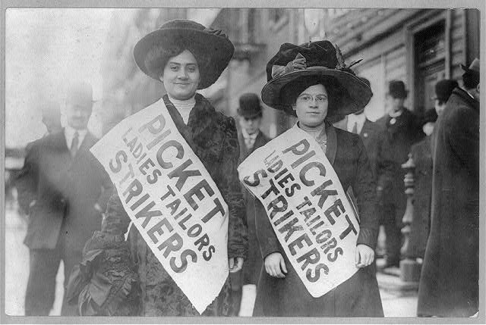
The Labor Movement

Slide 52
Changing Employee-Employer Relationships
Domestic system
Workers and employers knew each other personally
Workers could aspire to become employers
Factory system
Workers no longer owned the means of production (machinery)
Employers no longer knew workers personally
Factories often run by managers paid by the corporation
Relationships between employers and employees grew strained

Slide 53
Problems of the Factory System
Factories were crowded, dark, and dirty
Workers toiled from dawn to dusk
Young children worked with dangerous machinery
Employment of women and children put men out of work
Women and children were paid less for the same work
Technological unemployment – workers lost their jobs as their labor was replaced by machines
Notes:
Note: Silas Marner by George Eliot describes the changing textile industry due to technological advances.

Slide 54
Poor Living Conditions
Factories driven solely by profit
Businesses largely immune to problems of workers
Factory (also company or mill) towns
Towns built by employers around factories to house workers
Workers charged higher prices than normal for rent, groceries, etc.
Workers often became indebted to their employers
Created a type of forced servitude as workers had to stay on at their jobs to pay their debts
Considered paternalistic by workers
Some employers had workers’ interests at heart
But workers wanted to control their own lives
Workers were unsatisfied both inside and outside the factories
Notes:
Note: Pullman in Chicago, Illinois, is an excellent example of a well-intentioned factory town being disliked by workers.

Slide 55
Rise of Labor Unions
Before labor unions, workers bargained individually – “individual bargaining”
Before factories, a worker could bargain for better wages and working conditions by arguing his or her particular skills
But in factories, work is routine and one worker can easily replace another
With labor unions, workers bargained together as a group, or collective – “collective bargaining”
Organized groups of workers elected leaders to bargain on their behalf
Used tools (such as strikes) to gain rights

Slide 56
Weapons Used by Unions and Employers
Weapons Used by Employers
At-will employment
Company unions
Weapons Used by Unions
Boycotts
Check-offs
Individual bargaining
Injunctions
Laws that limit union activities
Lockouts
Open shops
Right-to-work laws
Welfare capitalism
Yellow-dog contracts
Closed shops
Collective bargaining
Direct political action
Favorable labor legislation
Feather-bedding
Lobbying
Picketing
Sabotage
Strikes
Union label
Union shops
Relocation
Blacklists
Threat of foreign competition
Outsourcing
Notes:
Note: Under employers’ weapons, “relocation,” “outsourcing,” and “threat of foreign competition” are relatively new, coming into play in the last quarter of the twentieth century. These weapons make for a lively classroom discussion. For example, students might examine reasons why automobile manufacturing plants have relocated to nonunionized southern states, the number of automobiles imported into the United States each year, and the number of parts (engines, transmissions, etc.) which are no longer made at an individual automobile plant but are instead made by smaller, nonunionized suppliers.

Slide 57
Legal Protections for Workers
Limited hours for women
Later – equal pay for equal work
Eventual end to child labor
Schools and requirements for school attendance grew as children were removed from the workforce
Health and safety codes
Minimum wage
Legalization of unions

Slide 58
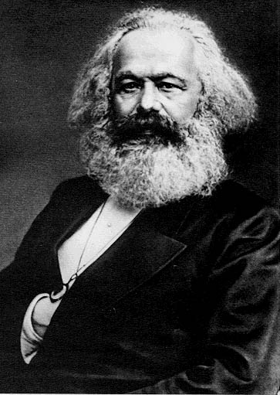
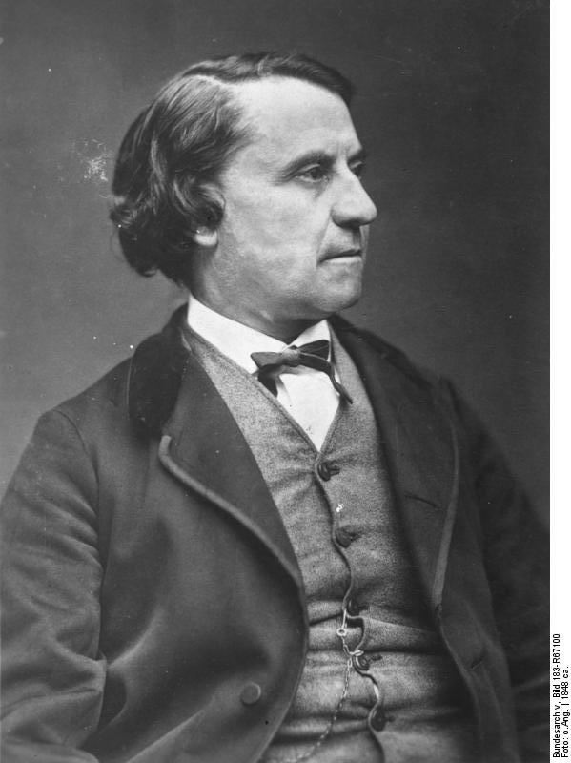
The Cooperative Movement and Socialism
Karl Marx
Louis Blanc

Slide 59
Cooperatives
Growth of cooperatives
Spread to other industries – banking, building, insurance, printing, etc.
By 1900 – 20% of Great Britain’s population had joined a cooperative
Concept spread internationally

Slide 60
Socialism
Socialists – viewed the capitalist system as inherently wrong
Belief that capitalism is designed to create poverty and poor working conditions because of its end goal of earning maximum profits for investors
Socialism – government owns the means of production
Belief that if the government (“the people”) owns the means of production, these factories and industries will function in the public (as opposed to private) interest

Slide 61
Karl Marx (1818-1883)
German socialist (communist) philosopher
Forced to leave Prussia for articles attacking the Prussian government
Relocated to France where he was considered too radical
Wrote Communist Manifesto with Friedrich Engels (1848)
Relocated to England where he lived out the rest of his life
Wrote Das Kapital – the “bible” of socialism (1867)
“Religion is the opiate of the people.”
Belief that religion is designed to keep people submissive to those in power by promising them that their reward is in heaven

Slide 62
Marxism – Communism
Economic Interpretation of History
Economic changes lead to historical changes.
Historically, the wealthy classes have held all power.
Class Struggle
History has been a struggle between the rich and the poor.
Surplus Value
Workers produce all wealth but receive only enough to survive.
Inevitability of Socialism
In the Industrial Revolution, the struggle is between the capitalists (owners of the means of production) and the proletariat (workers).
“Surplus value” (profit) of the workers’ labor goes to the capitalists.
Industrial wealth leads to the concentration of wealth among fewer and fewer capitalists, while the living and working conditions of the proletariat grow worse.
The proletariat will eventually rebel and create a socialist state.
Notes:
Note: Anti-Marxists might argue that Marx has been proven wrong because working conditions have improved. Marxists might argue that the struggle of the proletariat is not yet over. Still others might argue that Marx was right in some respects and wrong in others; that is, no truly socialist state has ever been created, but governments have established many socialist-type reforms and institutions. An interesting class activity is to have students create two lists—one listing the industries the federal government does control, and another listing those businesses which remain privately owned. This discussion should get interesting once the class starts discussing the federal government’s involvement with industries such as banking and automobile manufacturing following the recession of late 2008.
Note: Marx referred to himself as a “communist” to separate himself from Utopian socialists.

Slide 63
Soviet-backed Communism
Russian communism
Bolsheviks (Communists or Reds) won the Russian civil war against the Whites
World’s first socialist/communist state
Comintern – Communist International
Founded in Russia (Soviet Union) in 1919
Sought to spread worldwide communist revolution
Disbanded during World War II
Cominform – Communist Information Bureau
Founded in Soviet Union in 1947
Disbanded in 1956 as part of de-Stalinization
Soviet Union (and later China) spread communism through satellite states and via proxy wars during the Cold War
Notes:
Note: This information is provided as a general grounding for students who will later in the school year study the Cold War.
Note: It is very easy for students (and teachers) to confuse socialism/communism with totalitarianism. To avoid this trap, it might do well to focus on a largely socialist country like Norway rather than Stalin-era Russia. If one does look at Russia, the focus might be on Russia under Lenin rather than Russia under Stalin.

Slide 64
Syndicalists and Anarchists
Syndicalism and anarchism enjoyed popularity during the late 1800s and early 1900s
Syndicalism
Businesses and distribution of income managed by trade unions
Unions exist separate from the state as opposed to being part of the state
Anarchism
Belief that all governments are bad for the people
Advocates direct action to remove all forms of government
Various individual ideologies for post-government societal organization
Notes:
Note: President William McKinley was assassinated by an anarchist in 1901.

Slide 65
Social Catholic Movement
Opposed to the atheism of socialism
Yet also opposed to uncontrolled capitalism
Pope Leo XIII
Advocated Catholic socialism in 1891 through his support of workers’ associations
Pope Pius XI
1931 – condoned Catholic socialism while condemning communism
Stated that workers should share in the profits and management of industry
Followed by like-minded Protestant organizations
Numerous Christian-based socialist political parties still active in Europe

