Slide 1
6.3: Cognitive Models of Learning

Slide 2
Lesson #12
Objective(s): Outline the evidence that supports latent learning and observational learning. Identify evidence of insight learning.
Agenda: Bellwork, 6.3 notes and discussion, Closure
Bellwork:
What does S-R (Stimulus-Response) psychology lack?

Slide 3
Thinking
Behaviorists did not believe thought played much of a causal role in learning.
Radical Behaviorism-the belief that observable behavior, thinking, and emotion contribute to learning.
Thinking and emotions ARE behaviors, they’re just not observable.

Slide 4
S-O-R Psychology
Movement from S-R to S-O-R psychology in the past few decades; gradual transition from behaviorism to cognitivism
The organism interprets the stimulus before providing a response.
S and R is not mindless, or automatic
Think of how you react to bad news…
Is this your learned history?
Is this your interpretation?
S-O-R emphasizes the role of expectations in learning
Thought is crucial

Slide 5
Latent Learning
Tolman (1886-1959)
Reinforcement is not the end-all, be-all of leaning
Latent Learning-learning that is not directly observable
We learn things without showing them
Difference between competence and performance
Reinforcement is not necessary for learning
Cognitive Maps-spatial representations; internal spatial blueprint
Research falsified that reinforcement is necessary for learning

Slide 6
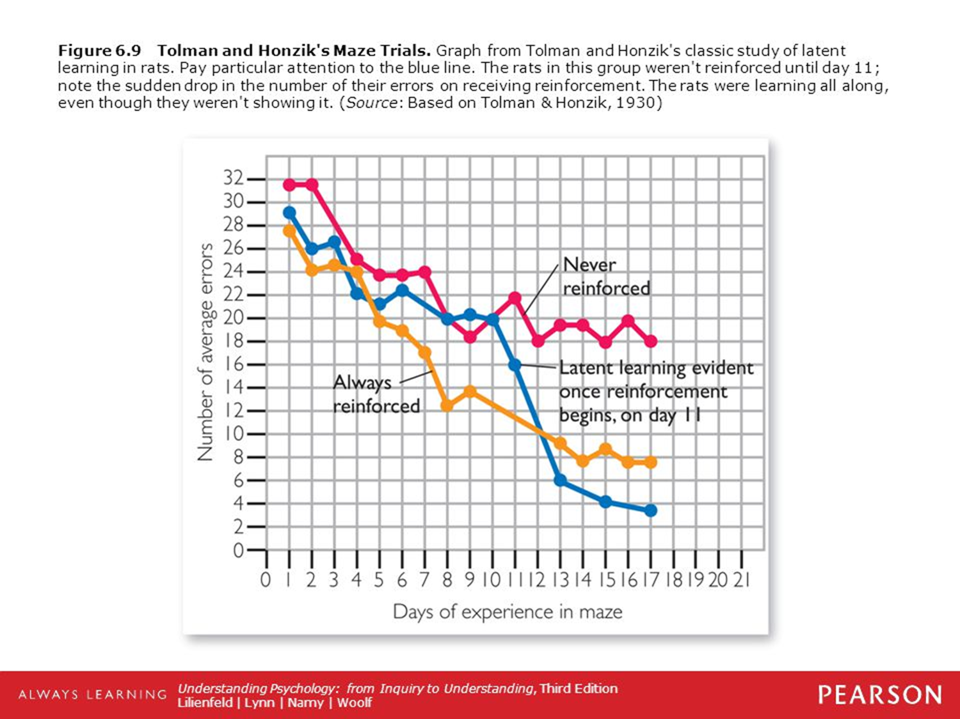
How does this image support latent learning

Slide 7
Observational Learning
A variant of latent learning
Learning by watching others
Models-parents, teachers, others
We can learn without reinforcement by taking cues from others, sparing us the expense of having to learn everything firsthand
Observational Learning of Aggression
Bobo Doll Video
Replicability

Slide 8
Observational Learning
Media Violence and Real-World Aggression
Does exposure to media violence, such as in films, movies or video games, contribute to real-world violence?
Correlational studies report yes (Correlation vs Causation)
What are the initial levels of aggression?
Are aggressive children more likely to watch violent shows and act aggressively?
Longitudinal studies say yes (Rule out rival hypotheses)
More compelling causal link but are not true experiments (lack random assignment)
Laboratory studies strongly suggest yes
Four lines of evidence—correlational, longitudinal, laboratory, field studies—each with strengths and weaknesses
Correlational, longitudinal, and field studies are strong in external validity, but weak in internal validity
Laboratory studies are strong in internal validity
All point to same direction—at least some causal relationship between media violence and aggression

Slide 9
Mirror Neurons and Observational Learning
Cell in the prefrontal cortex that becomes activated when an animal performs and action or observes it being performed
What do they do, exactly?
Empathy?
Link to ASD and psychopathy?

Slide 10
Insight Learning
Kohler
Aha reaction
Not a reflection of trial and error
A sudden understanding of the solution
Kohler’s research has shortcomings
Didn’t record all research
Observations are anecdotal and unsystematic
Chimps in same cage—observational learning

Slide 11
Closure
How are Kohler’s chimps different from Thorndike’s cats?

