Slide 1
6.2: Operant Conditioning

Slide 2
Lesson #11
Objective(s): Distinguish operant conditioning from classical conditioning. Describe Thorndike’s law of effect. Describe reinforcement and its effect on behavior, and distinguish negative reinforcement from punishment. Identify four schedules of reinforcement and the response pattern associated with each. Describe some applications of operant conditioning.
Agenda: Bellwork, 6.2 notes and discussion, Closure
Bellwork: What do the following have in common?
1-Using a bird feeder as a reward, a pigeon is taught to distinguish two types of paintings, making the pigeon an art aficionado.
2-Using fish as a treat, a trainer teaches a dolphin to jump, spin three times, splash, and propel itself through a hoop.
3-In a first attempt at playing tennis as 12 year old hit his opponents serve into the net the first 15 times. After two hours of practice, he returns the serve successfully more than half the time.

Slide 3
Operant Conditioning
Learning controlled by the consequences of the organism’s behavior; behavior that is shaped by what comes after it
Also called instrumental conditioning.
Distinguishing classical and operant conditioning
 | Classical Conditioning | Operant Conditioning
Target behavior is… | Elicited automatically | Emitted voluntarily
Reward is… | Provided unconditionally | Contingent on behavior
Behavior depends on… | Autonomic nervous system | Skeletal muscles

Slide 4
Law of Effect
States that if a stimulus is followed by a behavior resulting in a reward, the stimulus is likely to give rise to behavior in the future
Essentially when there is a reward for a response to a stimulus, it is likely to repeat in the future
Founded by E.L. Thorndike
Thorndike’s puzzle box
Lack of insight
Basis of operant conditioning
S-R Psychology-our most complex behaviors reflect the progressive accumulation of associations between stimuli and responses (due to the law of effect)

Slide 5
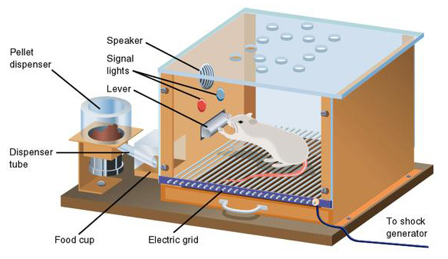
B.F. Skinner
Used electronic technology to research operant conditioning
Skinner Box-electronically records responses in a graph
No direct human observation-missing important behaviors?

Slide 6
Reinforcement, Punishment, & Discriminative Stimulus
Distinguishing Reinforcement from Punishment
 | Procedure | Effect on behavior | Typical Example
Positive Reinforcement | Presenting a stimulus | Increases target behavior | Gold star on good work to encourage studying
Negative Reinforcement | Removing a stimulus | Increases target behavior | Standing in one spot when you get a good phone signal
Positive Punishment | Presenting a stimulus | Decreases target behavior | Scolding an animal for chewing shoes
Negative Punishment | Removing a stimulus | Decreases target behavior | Taking away favorite toy to prevent future tantrums

Slide 7
Punishment
Shouldn’t confuse punishment with discipline
Discipline is punishment only if it decreases the probability of the behavior
Skinner argued against routine punishment to change behavior—reinforcement alone could shape most human behaviors for the better
Disadvantages of Punishment:
Tells organism what not to do, not what to do
Creates anxiety and can interfere with future learning
May encourage subversive behavior
Aggressive behavior models aggressive behavior
Research correlates the use of physical punishment with aggressive behavior in children
Physically abused children have a heightened risk for aggressiveness in adulthood and being abusers of children; “cycle of violence”
Genetic predisposition?
Children who are difficult to control?
Not replicable
Varies by race and culture
Stigmatization

Slide 8
Discriminative Stimulus
Any stimulus that signals the presence of reinforcement
Snapping fingers at a dog to come—dog comes to be petted

Slide 9
Key Concepts of Classical and Operant Conditioning
Term | Definition
Acquisition | Learning phase during which a response is established
Extinction | Gradual reduction and eventual elimination of a response after a stimulus is presented repeatedly
Spontaneous Recovery | Sudden reemergence of an extinguished response after a delay
Stimulus Generalization | Displaying a response to stimuli similar to but not identical to the original stimulus
Stimulus Discrimination | Displaying a less pronounced response to stimuli that differ from the original stimulus

Slide 10
Schedules of Reinforcement
The pattern of delivering reinforcement
Continuous reinforcement-reinforcing a behavior every time it occurs; results in faster learning but faster extinction
Partial reinforcement-occasional reinforcement of a behavior; results in slower extinction
Two dimensions:
Consistency of administering reinforcement (fixed or variable)

Slide 11
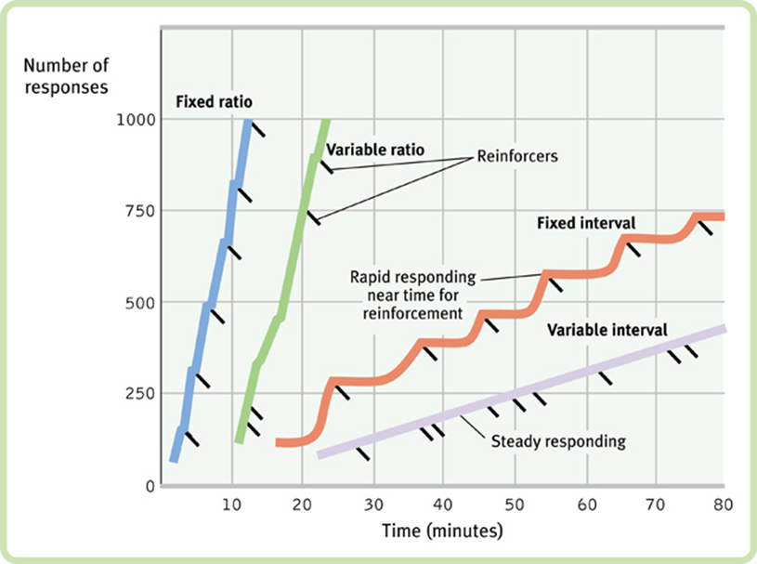
FR (Fixed Ratio)-reinforcement after a regular number of responses
VR (Variable Ratio)-reinforcement after a specific number of responses on average
FI (Fixed Interval)-provide reinforcement for producing the response at least once after a specified amount of time
Created scalloped pattern
VI (Variable Interval)-reinforcement for producing the response after an average time interval, with interval varying randomly

Slide 12
Applications to Daily Life
Animal Training
Shaping-conditioning a target behavior by progressively reinforcing behaviors that come closer to the target
Chaining-linking interrelated behaviors to cue the next behavior
Overcoming Procrastination
Stress is bad for our physical and psychological health
Tend to perform more poorly than early birds
Reinforce with behaviors that you want to complete
Therapeutic Applications of Operant Conditioning
Token economy-receiving tokens for appropriate behaviors (often used at psychiatric hospitals)
Helpful for improving behavior in ASD
Doesn’t always translate to the real world
Secondary reinforcers-neutral objects that become associated with primary reinforcers—item/outcome that naturally increases the target behavior

Slide 13
Putting the two together
Brain imaging demonstrates that classical and operant conditioning stimulate different parts of the brain
Why doesn’t our CR of fear eventually extinguish?
Two-process theory-we have been classically conditioned to fear something, then use negative reinforcement to enforce operant condition ourselves

Slide 14
Closure
Think of a bad habit you would like to break? Create an imaginary behavioral modification program using operant conditioning to help you change this bad habit.
Identify the bad habit, how to extinguish it, how to reinforce the new habit, and what schedule of reinforcement you might use.

