Slide 1
Chapter 2:4
Statistics: the language of psychological research

Slide 2
Lesson # 8
Objective(s): Identify uses of various measures of central tendency and variability. Explain how inferential statistics an help us to determine whether we can generalize from our sample to the full population. Show how statistics can be misused for purposes of persuasion.
Agenda: Bellwork, 2.4 notes, discussion
Bellwork:
How can numbers, or statistics, lead us away from the truth?

Slide 3
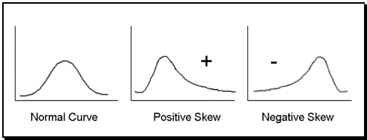
Two types of statistics: Descriptive and inferential
Statistics-application of mathematics to describe and analyze data
Descriptive Statistics-numerical characterizations that describe data
Central Tendency-measure of the central scores in a data set, or where a group tends to cluster.
Mean-average; best used when there is a bell curve
Median-middle score in a data set; may need to be used when data is positively or negatively skewed.
Mode-most frequent score in a data set; may need to be used when data is positively or negatively skewed.
Mean, Median, Mode
a. | b.
Sample IQ Scores: 100,90,80,120,120 Mean: (100+90+80+120+120)/5=102 Median: 80,90,100,120,120=100 Mode: 120 | Sample IQ Scores: 80,85,95,95,220 Mean: (80+85+95+95+220)/5=116 Median: 95 Mode: 95 *Mean affected by outlier

Slide 4
Descriptive statistics continued…
Variability-measures how loosely or tightly bunched scores are
Range-measure of variability that is the difference between the highest and lowest score
Easiest to measure, but deceptive since two sets with a similar central tendency can be bunched differently
Standard Deviation-measure of variability that takes into account how far each data point is from the mean
Answer the following using the two data sets below: A: 23,32,45,45,80 B: 22,35,45,58,58
Which data set has a smaller mean? | A B They are the same
2. Which data set has a smaller median? | A B They are the same
3. Which data set has a smaller mode? | A B They are the same

Slide 5
Inferential statistics
Inferential Statistics- mathematical methods that allow us to determine whether we can generalize findings from our sample to the full population
Statistical Significance-are our findings real?
Use a 0.05 level of confidence when deciding findings are trustworthy. This minimum level—5 in 100—is taken as the probability that the finding occurred by chance.
When the finding has been determined as chance less, it is statistically significant.
P<0.05
Practical Significance-is there real world importance?
The larger the sample size the greater the odds the result will be statistically significant, but it is useful in the real world?

Slide 6
Review the three scenarios in 2.4.
How can people lie with statistics?

