Slide 1
Chapter 2:3
Ethical issues in research design

Slide 2
Lesson #6
Objective: Describe the advantages and disadvantages of naturalistic observation, case studies, self-report measures, and surveys. Describe the role of correlational designs and distinguish correlation from causation. Identify the components of an experiment, the potential pitfalls that can lead to faulty conclusions, and how psychologists control for these pitfalls.
Agenda: Bellwork, 2.2 notes, discussion
Bellwork: Read, think, reflect
How many different versions of the scientific method have you been taught in your educational career?

Slide 3
Advantages and disadvantages of research designs
Naturalistic Observation-watching behavior in real-world settings without trying to manipulate their actions.
High in external validity-extent to which we can generalize findings to real-world settings.
Low in internal validity-extent to which we can draw cause-and-effect inferences from a study.
Case Study-examines one person or a small number of people in depth, often over an extended period of time.
Can provide existence proofs-demonstration that a psychological phenomenon can occur; allows us to study rare or unusual phenomena; offers insights for later testing
Typically anecdotal; doesn’t allow for causation

Slide 4
Advantages and disadvantages of research designs
Self-reporting-questionnaires or surveys that ask someone directly information about themselves.
Random selection-key to generalization; Nonrandom selection can lead to misleading conclusions
Reliability-consistency of measurement
Test-retest-a reliable questionnaire yield similar results over time
Interrater reliability-agreement on characteristics being measured
Validity-extent to which a measure assesses what it claims to measure
Reliability is necessary for validity but reliability can be invalid
Its cheap and easy to administer.
Respondents do not always possess enough insight into their own self to report accurately. Narcissistic individuals will paint themselves in a more positive light than others see them. Self-report questionnaires assume people are being honest.
Response sets-tendency to distort their answers, often in a way to paint themselves in a positive light.
Malingering-tendency to make ourselves appear psychologically disturbed with the aim of achieving a clear-cut personal goal.
Often others are better equipped to report on you, than yourself because you have “blind spots”.
Halo effect-allowing one positive characteristic to spill over into another.
Horns effect-providing poor ratings based on other poor characteristics.

Slide 5
Do you think you would accurately self-report on a personality test?
What about on job performance rating?
Are you aware of your own “blind spots”?
Have you ever associated a person with good or bad characteristics based on one good or bad characteristic?

Slide 6
Advantages and disadvantages of research designs
Correlation-research designs that examine the extent to which two variables are associated.
What are some examples of things that your typically correlate?
Conclusions from correlations are limited because we can be sure why predicted relationships exist.
Words such as associated, related, linked, went together indicate a correlational study.
Positive, Zero, Negative
Positive-as one variable increases, so does the other
Zero-variables don’t go together at all
Negative-variables go in opposite directions
Correlation coefficients-statistics that psychologists use to measure correlations
Absolute value is used to find out how strong a correlation coefficient is.

Slide 7
Identify the Type of Correlation
1. The more days participants reported exercising per week, the lower their weight tended to be. | Positive b. Negative c. Zero
2. Participants reaction times tended to increase when their blood alcohol level increased | Positive b. Negative c. Zero
3. People who missed more days of class tended to have lower GPAs | Positive b. Negative Zero
4. There is no systematic relationship between IQ and head size | Positive b. Negative Zero
5. The more negative life events people experience, the more likely that they are diagnosed with depression. | Positive b. Negative Zero
6. There is no relationship between a student’s height and her exam scores in a class. | Positive b. Negative Zero
Notes:
1-negative
2-positive
3-positive
4-zero
5-positive
6-zero

Slide 8
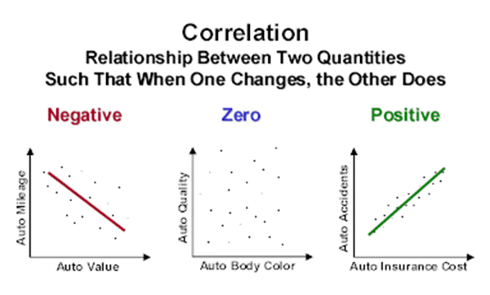
Advantages and disadvantages of research designs
Scatterplot-grouping points on a two-dimensional graph in which each dot represents a single person’s data.
Illusory correlation-perception of statistical association between two variables where none exists.
full moon and odd occurrences
Joint paint and rainy weather
Forms the basis for many superstitions
What are some other examples of illusory correlation?

Slide 9
Advantages and disadvantages of research designs
Correlation vs Causation-Can we be sure A causes B? A relationship exists but we mistake it as a causal relationship.
Facebook addiction affects brain like cocaine
Low self-esteem shrinks brain
Secret to long life is to stay in school

Slide 10
Advantages and disadvantages of research designs
Experimental Design-Research design characterized by random assignment of participants to conditions and manipulation of an independent variable. Permit cause-and-effect relationships unlike other research designs.
Two Components:
Random Assignment-randomly assorts participants into two groups.
*Random selection deals with initial choosing whereas random assignment deals with how you assign participants after they are chosen.
Experimental group-receives the manipulation
Control group-no manipulation
Variable Manipulation
Independent Variable-the manipulated variable
Dependent Variable-no manipulation; allows the experimenter to see whether the manipulation has an effect
Operational Definition-a working definition of what is being measured

Slide 11
Experimental design…continued
Confound/Confounding Variable-any variable that differs between the experimental and control groups, other than the independent variable.
Cause and Effect: Permission to Infer-experimental designs allow us to infer cause and effect relationships using the criteria
Is this study an experiment?
If it isn’t, don’t draw causal conclusions.

Slide 12
Pitfalls in experimental design
Placebo Effect-improvement resulting from the mere expectation of improvement
Blind-unaware of whether one is in the experimental or control group. If patients are not blind, a confound is generated.
“Blind is broken” is when participants what group they are in. Can result in…
Patients in experimental group can improve more than patients in the control group
Patients in the control group can try to beat out the patients in the experimental group, aka the John Henry effect
Placebo show many of the same characteristics as actual drugs (more powerful at higher doses, injection through a needle, addiction, price)
Up to 80% as effective in mild to moderate psychological cases
Actual medications have clear edge in severe cases and in physical illnesses

Slide 13
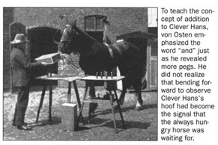
Pitfalls in experimental design
Nocebo Effect-harm resulting from the mere expectation of harm
What examples from the realm of superstition might be nocebo effect?
Experimental Expectancy Effect/Rosenthal Effect-when hypotheses lead them to unintentionally bias the outcome of a study.
How is confirmation bias an issue with the Experimental Expectancy Effect?
Double-blind-when neither researchers nor participants are aware of who is in the experimental or control group
Demand Characteristics-cues that participants pick up from a study that allow them to generate guesses regarding the researcher’s hypothesis
When participants think they know how the experimenter wants them to act, they may alter behavior accordingly. Can be combatted with cover stories, distractors, or filler items.
Extraordinary claims demand
extraordinary evidence.

Slide 14
Acupuncture study: Assess your knowledge
A researcher hypothesizes that acupuncture can allow stressed out psychology students to reduce their anxiety. Half receive treatment and half receive no treatment. Results are measured two months later, and findings show that people who received acupuncture are less stressed out than those who did not receive it.
Is this a correlational or experimental?
Experimental because there is random assignment to groups and the experimenter manipulated whether or not participants received treatment.
What are the intendent and dependent variables?
The independent variable is the presence vs the absence of acupuncture treatment. The dependent variable is the anxiety level of the students.
Is there confound in the design?
Potentially, in those who received treatment because their lower anxiety may have been a result of expectations of feeling better following treatment.
Can we infer cause and effect from this study?
Yes, but because of the confound we don’t know why the experimental group was less anxious. However, we can conclude something about the treatment reduced anxiety.

Slide 15
Fact vs fiction
It is impossible to conduct a double-blind study of whether psychotherapy is effective?

