Slide 1
Chapter 2:1
The beauty and necessity of good research design

Slide 2
Lesson #5
Objective: Identify two modes of thinking and their application to scientific reasoning.
Agenda: Bellwork, 2.1 notes, discussion
Bellwork: Read, contemplate, and discuss the following statement
In the early decades of the 20th century, a well-trained and esteemed psychiatrist named Henry Cotton (who was superintendent of a large mental health hospital in Trenton, New Jersey) removed hundreds of his patients’ teeth, tonsils, large intestines, spleens, gallbladders, and other organs based on the “theory” that serious psychological disorders are caused by bacterial infections.

Slide 3
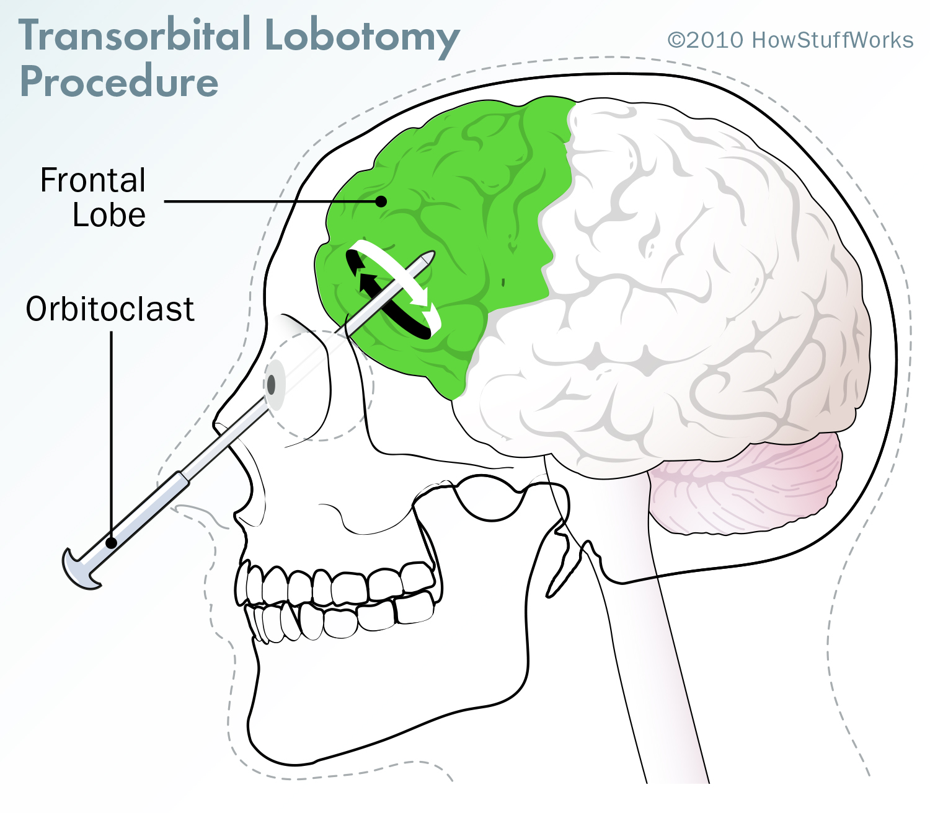
Why we need research designs
Prefrontal lobotomy-procedure performed on over 50,000 Americans—mostly in the 1940s and 1950s—to cure schizophrenia. Severed fibers connecting frontal lobes from the thalamus.
Egas Moniz of Portugal won a Nobel Peace Prize for Physiology or Medicine in 1949 for the procedure.
Believers saw that it worked, but did not conduct systematic research, but rather observation.
Research in controlled studies does not hold up to original research and rendered the procedure useless.
Did not fix schizophrenic behaviors such as hearing voices and holding persecutory beliefs
Resulted often in extreme apathy
How does this illustrate naïve realism and confirmation bias?

Slide 4
How can we be fooled: two modes of thinking
System 1 Thinking: intuitive thinking, gut hunches, snap judgements; requires minimal effort; brains largely on autopilot
Heuristics-mental shortcut or rule of thumb that helps us to streamline our thinking and make sense of our world.
But our heuristics are not always right.
What are some examples of this type of thinking?
System 2 Thinking: analytical thinking; slow and reflective; mental effort
What are some examples of this type of thinking?
Why is this important in psychological research?

Slide 5
Closure-Facilitated communication
Facilitated Communication
Thoughts?

