Slide 1
Chapter 1, Section 2
Psychological Pseudoscience

Slide 2
Lesson #2
Objective(s): Describe psychological pseudoscience and distinguish it from psychological science. Identify reasons we are drawn to pseudoscience.
Agenda: Bellwork, Psychological Pseudoscience
Bellwork:
Do you, or someone you know, believe in a conspiracy theory? Explain.
Can a conspiracy theory lead us to believe two logically consistent things at the same time? Explain.
Notes:
After giving students a chance to answer bellwork questions, discuss. All statements are false! Are you surprised? Where do you recall learning about these myths you thought were true? Why do you think many of these myths persist despite evidence to the contrary?
Conspiracy theories can lead us to believe two logically inconsistent things as the same time

Slide 3
Popular Psychology
About 3,500 self-help books are published each year—only 5 percent are tested!
The quality of the information can be good, misleading, or even harmful.
Many websites may offer helpful advice, but others may contain erroneous information.
Notes:
Misinformation explosion. Scant quality control. Growth of treatments and products that cure almost every ailment—largely untested.
It is important to think scientifically.
Association for psychological science, American psychological association, national institute of mental health—website that provide accurate knowledge regarding human behavior.

Slide 4
What Is Pseudoscience?
A set of claims that seem scientific, but aren’t
Pseudoscience lacks the safeguards against confirmation bias and belief perseverance that characterize science.
Testable beliefs that are not supported by the evidence
Notes:
2009 survey shows 25 percent believe in astrology in us. 26 believe that trees or other objects possess magical energies, 18 percent believe they’ve encountered ghosts, and 15 percent have consulted psychics.
Many americans belive these work although scientific evidence is weak. Especially in case of psychics or non existent science of astrology. 20x more astrologers than astronomers in us.

Slide 5
Three Major Warning Signs of Pseudoscience
Warning signs of pseudoscience
Ad hoc immunizing hypotheses
Escape hatches to protect against falsification, usually a loophole or exception for negative findings.
Overreliance on anecdotes
Anecdotes are often not representative, but can’t tell us about cause and effect and are often difficult to verify.
Lack of self-correction-people fall prey to belief perseverance.
Notes:
Ad hoc immunizing hypotheses-under lab conditions psychics would say their powers did not work because of skeptical “vibes” interfering with their abilities.
Overreliance on anecdotes-anecdata (informal term for anecdotal evidence).often based on just a few people. Rarely tell us anything about cause and effect. Difficult to verify.
Lack of self correction-belief perseverence

Slide 6
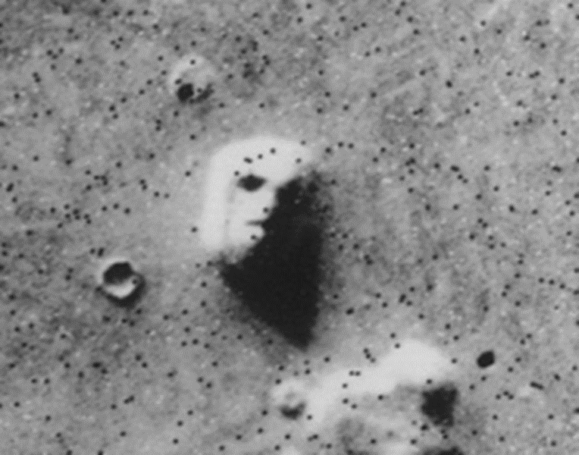
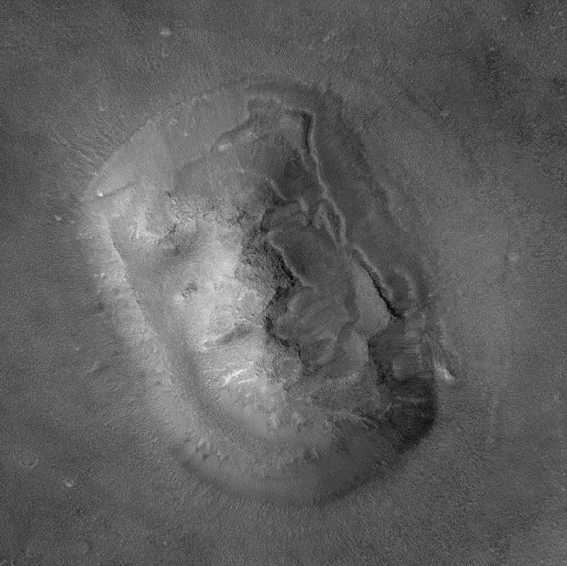
Why are we drawn to Pseudoscience?
Why are we drawn to pseudoscience?
Our brains are predisposed to make order out of disorder and make sense out of nonsense.
Patternicity-tendency to see patterns in meaningless data.
“Better safe than sorry.”
Laws of probability
Streaks-people underestimate the probability of consecutive sequences.
Tendency to detect eerie coincidences among persons or events.
Tendency to see meaningful images in meaningless visual stimuli.
Notes:
Patterniticy-we want to seek patterns and connections among events. Possible that two seemingly unconnected/coincidental events are actually unrelated (laws of probability).
Streaks-have students in pairs flip a coin 10 times and record either H or T each time. Then give percentage of H/T landing.
Eerie coincidences-easy to detect differences if we actually look for them.

Slide 7
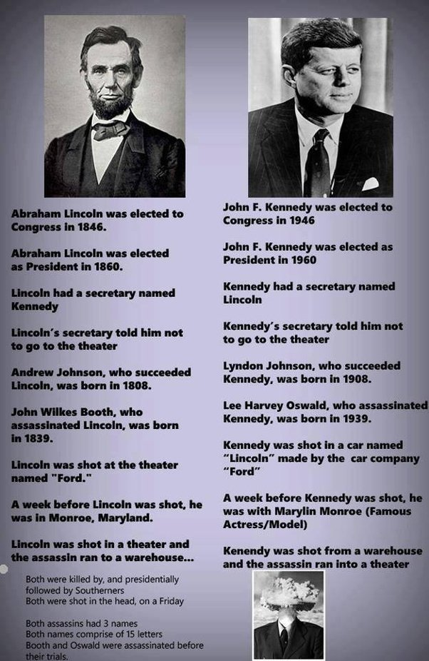
BUT…
-Lincoln was a Republican/Kennedy a Democrat
-Lincoln shot in
DC/Kennedy in
Dallas
-Lincoln has a beard/Kennedy did not

Slide 8
Why are we drawn to Pseudoscience?
Find comfort in our beliefs
Terror management theory-our awareness of our own inevitable death leaves us with an underlying sense of fear, or dread.
Notes:
“hope springs eternal”-offers us a sense of control in an unpredictable world
In a lab setting people who were given an unsolvable puzzle or were asked to recall a traumatic event they were more liely than others to embrace superstitious beliefs and detect patterns in meaningless stimuli.
Terror management theory-we cope with this but adopting cultural worldviews that reassure us that our lives posses a broader meaning and purpose—one that is beyond our earthly existence. Explains popular paranormal beliefs such as astrology, esp, communication with the dead, life& death, reincarnation. These beliefs are comforting when confronted with our demise. Does not demonstrate paranormal claims are false, just they need to be evaluated for their own merits.

Slide 9
Thinking Clearly-Logical Fallacies
Learning to think scientifically can help us avoid falling prey to pseudoscience.
Emotional reasoning fallacy—using emotions rather than evidence as the guide
Bandwagon fallacy—Lots of people believe it, so it must be true.
“Not me” fallacy—Other people may have those biases, but not me.
Notes:
Emotional reasoning fallacy-daycare has negative emotional effects on children gets me upset so I refuse to believe it.
Bandwagon-a lot of people believe it so there has to be a reason why
Not me fallacy-biases don’t apply to me

Slide 10
Why Should We Care? LO 1.2b Identify reasons we are drawn to pseudoscience.
Because pseudoscience can be very dangerous
Three major reasons to be concerned:
Opportunity cost
Direct harm-
Inability to think scientifically
Although not foolproof, scientific thinking is our best safeguard against human error.
Notes:
Opportunity costs-pseudoscience treatments can redirect people from seeking effective treatments. In US data suggest that 1/3 of people with major depression receive any treatment at all.
Direct harm-when the pseudoscience treatments are actually harmful. rebirthing therapy (example of 10 year old girl who died through this therapy which was supposed to help reconnect/reattach to her parents)

