Slide 1
Chapter 1, Section 1
What is Psychology? Science Versus Intuition

Slide 2
Lesson #1
Objective(s): Explain why psychology is more than just common sense. Explain the importance of science as a set of safeguards against biases.
Agenda: Bellwork, Intro to Psychology
Bellwork: Answer the following questions (T/F)
1. Most people use only about 10% of their brain.
2. Newborn babies are virtually blind and deaf.
3. Hypnosis enhances the accuracy of our memories.
4. All people with dyslexia see words backwards (fac to caf).
5. In general, it is better to express anger than to hold it in.
6. The lie detector test is 90-95 percent accurate at detecting falsehoods.
7. People tend to be romantically attracted to individuals who are opposite from them in personality and attitudes.
8. The more people present at an emergency, the more likely it is that at least one of them will help.
9. People with schizophrenia have more than one personality.
10. All effective psychotherapies require clients to get to the root of their problems in childhood.
Notes:
After giving students a chance to answer bellwork questions, discuss. All statements are false! Are you surprised? Where do you recall learning about these myths you thought were true? Why do you think many of these myths persist despite evidence to the contrary?

Slide 3
Popular Psychology
Television
Movies
Reading
Magazines
Social media
Notes:
Everyday network of sources of psychological knowledge about human behavior. Not all common sense is useful and some is completely wrong. Psychology strikes many people as obvious or self-evident but familiarity with human nature does not equal understanding of human nature.

Slide 4
What Is Psychology?
Explain why psychology is more than just common sense.
Explain the importance of science as a set of safeguards against biases.

Slide 5
What Is Psychology?
First, it’s not very easy to define.
Our definition will be that psychology is the scientific study of the mind, brain, and behavior.
As a discipline, psychology spans many levels of analysis.
Runs from biological to social influences
When we look at all levels of analysis we get a more complete picture, not just one perspective.
Notes:
Hows and whys of human behavior—the things that cause thoughts, feelings, and actions. But there are no simple explanations to human behavior.
Do you believe that biological or environmental factors have a greater impact on our behavior?
Levels of analysis-use city analogy. It is important to have multiple perspectives or analyze behavior from multiple levels of analysis.

Slide 6
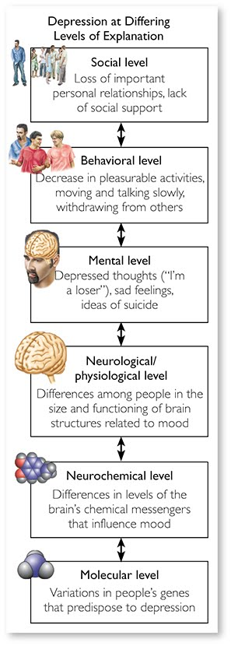
Figure 1.1 Levels of Analysis in Depression
Source: Based on data from Ilardi, Rand, & Karwoski, 2007

Slide 7
What Makes Psychology Distinctive—and Fascinating
Five factors make the study of psychology very difficult, but very rewarding.
1.Human behavior is difficult to predict; actions are multiply determined-produced by many factors.
2. Psychological influences are rarely independent of each other.
3. People display individual differences in thinking, emotion, and personality.
4. Reciprocal determinism-people influence each other.
5. Behavior is shaped by culture.
Notes:
Human behavior-it is difficult to explain complex human behaviors like violence from one factor-poverty, personality, bad upbringing, or genes. What is the cause of violence?
Influences-Ex: anorexia nervosa-eating disorder associated with anxiety proneness, compulsive exercise, perfectionism, excessive concern with body image, exposure to tv that features thin models, etc… can’t just focus on one thing such as perfectionism bc these people also have many of the same traits that people with anorexia have. Fact that these things are interrelated make it difficult to pinpoint a cause of anorexia.
Individual differences explain why different people respond differently to the same situation, such as an insulting comment from a boss. Another aspect that makes psychology fascinating and difficult. Explanations of behavior don’t apply to everyone.
Reciprocal determinism-extroverts may influence introverts to become more extroverted when together and that extroverted behavior feeds the extrovert to be even more extroverted.
Behavior shaped by culture-give tiger example. Americans and Europeans look at the tiger while Asian American focus more on the surrounding parts of the image.

Slide 8
Why We Can’t Always Trust Our Common Sense
Birds of a feather flock together.
Absence makes the heart grow fonder.
Better safe than sorry.
Two heads are better than one.
Actions speak louder than words.
6. Opposites attract.
7. Out of sight, out of mind.
8. Nothing ventured, nothing gained.
9. Too many cooks spoil the broth.
10. The pen is mightier than the sword.
Notes:
To most of us these proverbs are true but each one contradicts the proverb across from it. They cant both be simultaneously true. Typically we do not notice the contradictions until someone points them out to us. A reminder as to why psychology isn’t just common sense and must use a scientific approach to human understanding.

Slide 9
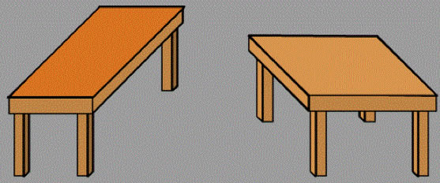
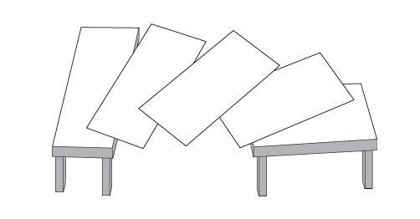
Why We Can’t Always Trust Our Common Sense
We trust our common sense due to naïve realism-”seeing is believing” or trusting our intuitive perceptions of the world and ourselves.
Most of the time, yes.
Evaluating ourselves and bias.
Notes:
Yes-example of truck coming at you while you're driving, you should get out of the way.
Common sense assures us that people who don’t share our political opinions are biased and we are objective but psychological research demonstrates that nearly everyone tends to evaluate political issues in a biased fashion. Tendencies toward naïve realism lead us to draw incorrect conclusions about human nature. In many cases believing is seeing is actually the reverse. Our beliefs shape our views of the world in ways we do not realize.

Slide 10
When Our Common Sense Is Right
Comes in handy in many situations and can guide us to the truth.
Can be a helpful guide when generating hypotheses that scientists can later use for more rigorous investigation.
We must learn when, and when not to, use our common sense assumptions.
Notes:
I someone trustworthy or not.
Happy employees are more productive employees. This is backed up by research.
This will help us become more informed consumers of popular psychology and make better real world decisions.

Slide 11
Psychology as a Science
A systematic approach to empirical evidence.
Observations receive scrutiny and are retained or discarded.
Scientific theory is an explanation for a large number of findings in the natural world (i.e. evolution)
-misconception=a theory explains one specific event.
-misconception=a theory is just an educated guess.
Hypothesis is a testable prediction derived from a scientific theory.
Notes:
Psychology is not considered a science by many people.(52 percent) People believe psychology is imply listening and talking to people and asking them questions. This skepticism may be in part due to psychologists who appear on tv or other media outlets that are not actually using scientific methods to come to conclusions.
A theory is multiple observations tied into one big idea. Hypothesis are specific predictions derived from theories.

Slide 12
Theory or Hypothesis?
Sarah’s motivation for cheating was fear of failure.
Darwin’s evolutionary model explains the changes in species over time.
The universe began in an explosion about 14 billion years ago.
Our motivation to help a stranger in need is influenced by the number of people present.
Crime rates in Nashville increase as the temperature rises.
Notes:
1-hypothesis
2-theory
3-theory
4-hypothesis
5-hypothesis

Slide 13
Safeguards Against Bias
Confirmation Bias- tendency to seek out evidence that supports our beliefs and deny, dismiss, or distort evidence that contradicts them.
Most crucial bias in psychology
Belief Perseverance-tendency to stick to our initial beliefs even when evidence contradicts them.
Notes:
Confirmation bias-we focus on evidence that bolsters our beliefs including daily life, friendships, romance, politics, and sports. When it comes to judging right or wrong our side almost always seems to be in the right and the other side in the wrong.
Belief perseverance- don’t confuse me with the facts; none of us wants to think we are wrong; reluctant to give up our beliefs

Slide 14
Diagram of Wason Selection Task

Slide 15
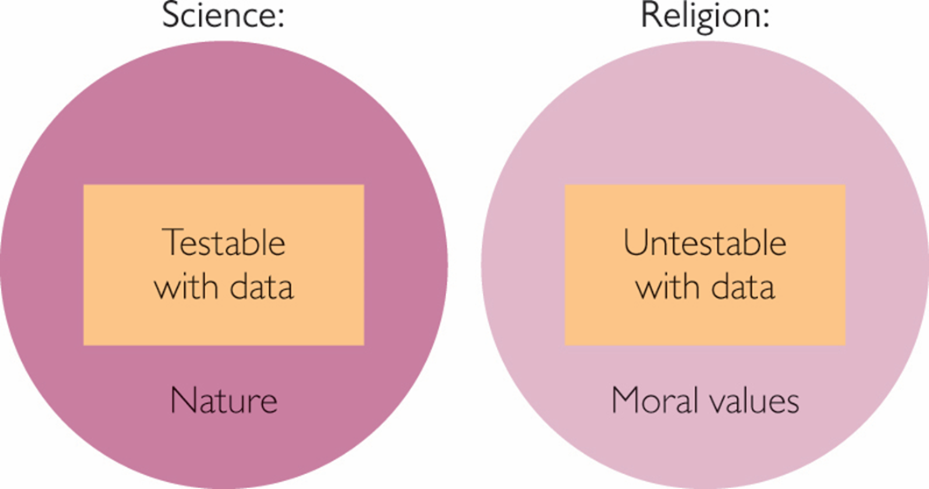
Metaphysical Claims
Metaphysical claims-non-testable assertions that fall outside the realm of science
The existence of God, the soul, or the afterlife
Notes:
We can not test these claims with scientific methods. But are still important claims or questions. We can not test outside of the natural world.

Slide 16
We Might Be Wrong
Good scientists are aware they might be wrong.
Scientific knowledge is always tentative and open to revision.
Science forces us to question our findings and conclusions.

