Slide 1
Chapter 10
Human Development

Slide 2
10.4
The Developing Personality: Social and Moral Development

Slide 3
Lesson #18
Objective(s): Describe how and when children establish emotional bonds with their caregivers. Explain the environmental and genetic influences on social behavior and social style in children. Determine how morality and identity develop during adolescence and emerging adulthood. Identify developmental changes during major life transitions in adults. Summarize different ways of conceptualizing old age.
Agenda: Bellwork, 10.4 Notes and Discussion, Closure
Bellwork: Think, reflect, discuss…

Slide 4
Social Development in Infancy and Childhood
Infants prefer looking at faces over anything else, especially mom’s
Stranger Anxiety-a fear of strangers that develops at 8-9 months of age and last until about 12-15 months
Good evolutionary sense given motor skills at this age
Temperament-basic emotional style that appears early and is largely genetic. 3 types:
Easy
Difficult
Slow to warm up
Temperament has bidirectional influences
Behavioral inhibition-”scaredy cats”
In about 10% of children; are at higher risk for anxiety disorders
Infants with low levels of behavioral inhibition have higher risk for impulsive behaviors and risk taking behaviors
Cultural difference can determine temperament to an extent
Prenatal environment also relates to temperament

Slide 5
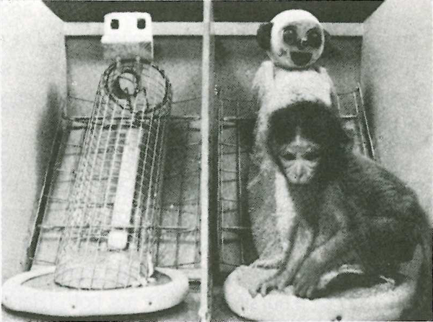
Attachment
Imprinting: humans do not imprint the way goslings do, but do bond with caretakers shortly after birth during what is called the sensitive period
Prolonged detachment creates short and long-term psychological problems (Romanian orphanages), depending on the detachment length
Behavioral and social problems
Contact Comfort: the positive emotions afforded by touch
We seek contact for more than just nutrition
Monkey study

Slide 6
Attachment Styles
Secure-plays independently, skeptical of stranger, upset when mom leaves, happy when she returns; uses mom as a secure base
More well-adjusted, helpful, and empathic
Insecure-avoidant-independent without needed mom, indifferent to strangers, no distress when mom leaves, little reaction upon her return
Insecure-anxious-does not explore independently, distressed with strangers, panics when mom leaves, mixed emotional reaction to mom’s return
More likely to be mistreated by peers and disliked
Disorganized-shows no consistent set of emotions in study
Unreliable study
Children’s attachment style can differ if life circumstances change
Strong early preference for mom disappears around 18 months in 2 parent household
Different attachment style seen with different caretakers (relationship)
Bidirectional influence in temperament, parenting style, and attachment style

Slide 7
Influence of Parenting on Development
Study of 3 styles, conducting with U.S. white middle-class families:
Permissive-lenient, considerable freedom, use discipline sparingly
Authoritarian-strict, little opportunity for free play and exploration, punishment when children don’t respond appropriately to demands, show little affection
Works best in collectivist cultures
Authoritative-somewhere in the middle; supportive but firm
Children show best social and emotional adjustment and least behavioral problems
Uninvolved-neglectful
Children worst in social and emotional adjustment with most behavioral problems
Bottom line=good enough is good parenting, or average expectable environment-provides children wit basic needs for affection and discipline

Slide 8
Continued…
Peers play important role in development
Fathers general give less attention, affection, and less time; physical play with father is important; boys and girls choose father as playmate over mother
Children of single-parent household are more likely to have behavioral problems and engage in crime. Single parents are more likely to be poor, have low education, stressed, move more often
Children of same-sex parents do not differ any from those of traditional 2 parent households
Divorce typically has little long-term impact on children. In the short-term positive results come from when parents have a volatile relationship and separate; negative results come from parents who display little to no issues; kids with educated moms fare better; kids with educated fathers fare worse

Slide 9
Self-Control
The ability to inhibit an impulse to act
Early capacity for delayed gratification is good
Cope with frustration
Higher test scores
Handling stress

Slide 10
Development of Gender Identity
Gender identity-sense of being male or female
Gender role-a set of behaviors that tend to be associated with being male or female
Cisgender-when biological sex and identity match up
Higher social tolerance for “tomboys’; lower for “sissy” boys
Transgender-when sex and identity do not match up
Some report being at odds with sex and identity as young as five; not confused or delayed in gender identity; quite typical for their gender, just not their given sex; those who are not supported in family or school setting often suffer psychologically
Bathroom Bill Video

Slide 11
Development of Gender Concepts
Some gender difference apparent in early infancy; boys and girls less than one year prefer to play with certain types of toys when given the opportunity to play with both
Boys-balls, guns, trucks
Girls-stuffed animals, dolls, cookware
Remarkable the same patterns appear in non-human primates
As early as age 3 boys and girls prefer to play with same sex, or gender separation
Also occurs in non-human primates
Are these really biological predispositions? Nature is almost always amplified by nurture; fathers are more likely than mothers to enforce stereotypes
Teachers respond to gender stereotypes, responding better to girls when they are “needy” and to boys with more attention when they exhibit aggressiveness

Slide 12
Social and Emotional Development in Adolescence

Slide 13
Life Transitions in Adulthood

Slide 14
Closure

