Slide 1
Chapter 10
Human Development

Slide 2
10.3
The Developing Mind: Cognitive Development

Slide 3
Lesson #17
Objective(s): Understand major theories of how children’s thinking develops. Explain how children acquire knowledge in important cognitive domains. Describe how attitudes toward knowledge change during adolescence.
Agenda: Bellwork, 10.3 Notes and Discussion, Closure
Bellwork: Think, reflect, discuss…

Slide 4
Theories of Cognitive Development
Cognitive development-how we acquire the ability to learn, thinking, communicate and remember over time
Theories differ in three ways:
Stagelike (sudden spurts of knowledge followed by periods of stability) or continuous (gradual, incremental changes)
Domain-general (all cognitive areas affected in tandem) or domain-specific (cognitive skills develop independently)
What is the main source of learning? Physical experiences, social interaction, or biological maturation

Slide 5
Piaget’s Theory
First scientist to develop a comprehensive theory of cognitive development leading to cognitive thinking as a distinct discipline. Said children’s thinking is fundamentally different than adult thinking.
Piaget was a stage theorist—proposing that children have specific transition points followed by periods in which their understanding of the world stabilizes
Believed the end point of cognitive development is the ability to think logically about hypothetical problems
Piaget’s stages are domain-general
Emphasized physical experiences in learning
Proposed that cognitive change is the result of equilibration—or maintaining a balance between experiences of the world and understanding it

Slide 6
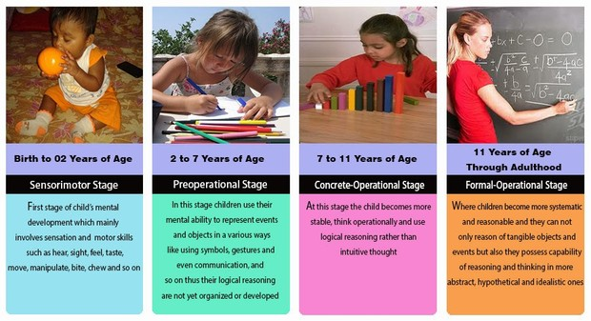
Piaget’s Stages of Development

Slide 7
Piaget’s Theory
Establishing equilibration:
Assimilation-the process of absorbing new experience into current knowledge structures.
During this process world views remain unchanged , but a child reinterprets new information to fit into current understanding of the world
Accommodation-the process of altering beliefs to make it compatible with experiences
Stage changes are a result of accommodation
Forces the child to look at the world differently
Cons to Piaget’s Theory
Inaccurate due to development being mostly continuous
Development is less domain-general that proposed
Relied on children to report their own reasoning capabilities
Studies were culturally and personally biased
Pros to Piaget’s Theory
Led to children being viewed as different rather than immature adults
Characterized learning as active rather than passive
Explored cognitive process across many domains of knowledge

Slide 8
Vygotsky’s Theory
Explored how social and cultural factors influenced learning
Domain-specific learning occurs
Emphasized social interaction
Scaffolding-learning mechanism in which parents/caretakers provide initial assistance in learning but gradually remove the assistance as children become more competent
Zone of proximal development-phase during learning which children can benefit from instruction
Modern day cognitive theorists generally take a position between Piaget and Vygotsky and regard learning as continous

Slide 9
Cognitive Landmarks of Early Development
Object permanence-when children are able to understand that when something is out of view it still exists
A major barrier is “folk” or “naïve” psychology, or when we go against our own common sense and reasoning about the physical world.
Attributing intentions or goals to objects that would violate basic physics principles
Classifying the world-sorting and categorizing (colors, shapes, sizes, types of animals, types of foods, etc…)
Concept of self-develops between toddler and preschool years
Theory of mind-ability to reason about what other people know or believe; understanding that other peoples perspectives can differ from theirs
This can be difficult for young children—tested through false-belief task
Counting-what amount of numbers mean, a bunch, a few, and order of numbers
Counting and mathematical skills develop at different rates across cultures

Slide 10
Cognitive Changes in Adolescence
When we achieve our most abstract level of reasoning
Planning, decision making, and impulse control continue to develop through early adulthood
Limbic structures of the brain involved in social structures are more active in adolescence explaining why teens are more susceptible to peer influences and risk-taking
Teens make adult-like decisions without a full deck of decision making cards
Risk-taking appears to be more associated with opportunity rather than higher propensity towards risk taking, suggesting risk taking is cultural and biological
Adolescents understand there are consequences for risky behavior, but engage in them anyway
Brain development during this time also affects learning, motivation, motor coordination, and inhibitory control
As adolescents become older, perspectives toward knowledge changes—becoming more grey vs black and white

Slide 11
Cognitive Function in Adulthood
The ability to recall information such as names, objects, places—decrease after age 30
Speed of processing also declines
Brain matter actually decreased as we age
Brain becomes less efficient at “emptying the trash”
Cued recall and recognition remain intact
Information pertinent to everyday life stays intact
Older adults perform better on knowledge and vocabulary tests—accumulated knowledge—Older is wiser!

Slide 12
Closure

