Slide 1
Chapter 10
Human Development

Slide 2
10.2
The Developing Body: Physical and Motor Development

Slide 3
Lesson #16
Objective(s): Track the trajectory of prenatal development, and identify barriers to normal development. Describe how infants learn to coordinate motion and achieve major motor milestones. Describe physical maturation during childhood and adolescence. Explain which aspects of physical ability decline during aging.
Agenda: Bellwork, 10.2 Notes and Discussion, Closure
Bellwork: Think, reflect, discuss…
Can you think of both an environmental and genetic explanation for why adolescents in gangs become trouble makers?

Slide 4
Conception and Prenatal Development
Prenatal-before birth
The most dramatic changes occur early on in pregnancy, following conception, when the sperm fertilizes the egg to produce a zygote.
Three Stages:
Germinal Stage-when the zygote multiplies identical cells that yet to take on specific jobs called the blastocyst.
Embryonic Stage-begins during the middle of the second week when the zygote become an embryo. During the 2nd-8th weeks of development limbs, facial features, major organs and body parts take form.
Spontaneous miscarriage during this time is common (25% of the time)
By the 9th week, beginning the fetal stage, major organs are formed and the heart beats. At this point on, the fetus is “bulking up”.

Slide 5
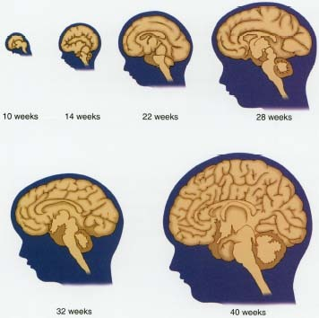
Brain Development-18 days and beyond
Unlike most organs our brains continue to develop into early adulthood
Proliferation-from the 18th day through the 6th month of pregnancy neurons develop at an astronomical rate (up to 250,000 brain cells per minute)

Slide 6
Obstacles to Normal Fetal Development
Premature Birth-considered to be less than 36 weeks although viability begins around 25 weeks.
Premature birth presents higher risk of damage to physical and cognitive development
Low Birth Weight-less than 5 ½ pounds for a full-term baby
Linked to high risk of death, infection, developmental delays, and psychological disorders
Is this a reflection of low birth weight or other issues during pregnancy?
Low birth weight babies are likely to be born of single mothers, young mothers, and women with lower educational levels with fewer financial resources, and those who did not receive prenatal care
Hazardous Environmental Influences-Teratogens are environmental factors that can affect prenatal development negatively.
These include drugs, alcohol, chicken pox, anxiety, depression, and chronic stress
All of these affect the chemical and physiological environment of the fetus
Fetal Alcohol Syndrome-effects of alcohol exposure can result in learning disabilities, delays in physical growth, facial malformations, and behavioral disorders
Genetic Disorders-caused by random errors in cell division resulting in impaired development of organs or organ systems.
Could be as minor as a birthmark or as major as an intellectual or physical disability

Slide 7
Infant Motor Development
Infants are born with reflexes such as the sucking and rooting reflexes which instinctually help them seek nutrition from their mother
Motor behaviors are bodily motions that occur as a result of self-initiated force that moves the bones and muscles
Major milestones are sitting up, crawling, standing unsupported, and walking
Virtually all infants across all cultures complete these milestones in this sequence
Factors affecting motor development could be related to things such as body weight and cultural or parental practices such as swaddling for an extended period of time.

Slide 8
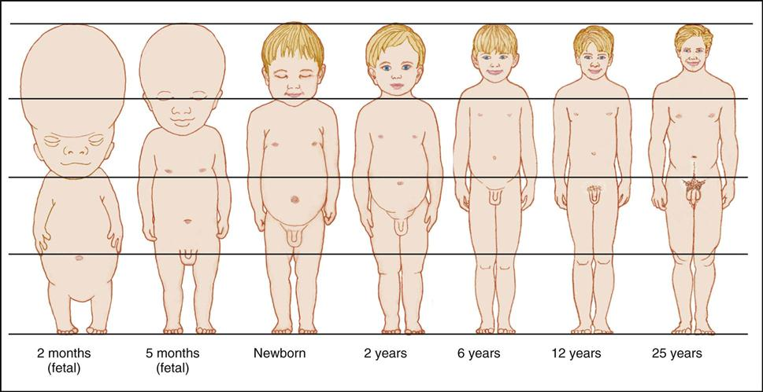
Growth and Physical Development Throughout Childhood
Growth spurts
Occurring every 30-55 days in children ages 3-16
Infant growth spurts are often sudden and are marked with more sleeping

Slide 9
Physical Maturation in Adolescence
Adolescence-the transitional period between childhood and adulthood when our bodies reach physical maturity, or puberty
The pituitary glad stimulates growth, the reproductive system releases sex hormones
Changes in primary sex characteristics (reproductive organs and genitals)
Changes in secondary sex characteristics (breasts, voices, public hair)
Androgens causes boys to increase in muscle tissue, grow facial and body hair, the shoulders to broaden, and spermarche (first ejaculation); in girls it induces physical growth and pubic hair
Estrogen causes girls’ hips to widen, promote breast growth, uterus and vaginal maturation, and the onset of menstruation, or menarche
The spermarche is not as closely tied to physical maturation as the menarche
The timing of puberty is genetically, environmentally, and culturally influenced

Slide 10
Physical Development in Adulthood
Most of us reach our physical peaks in our early 20s—strength, coordination, cognitive processing, and physical flexibility
As we age we experience a decrease in muscle and an increase in body fat; basic sensory processes decline such as vision and hearing
Fertility in women sharply declines after age 30
Menopause-a major milestone in women which signals the termination of reproduction potential
Men experience nothing compared to menopause but can have difficulty experiencing erections, achieving ejaculation, and a decline in sperm count
Both reproductively older women and men present a higher risk for having children with developmental disorders
Age also affect motor coordination

Slide 11
Closure

