Slide 1
Assignment #1-Short Analysis

Slide 2
Assignment #1-Short Analysis
Directions: On a separate piece of paper, analyze the formal elements of art for both prompts.
You will have 15 minutes to write freely for each slide. A short, informal class discussion will follow each analysis.
You may label each slide #1 and #2, respectively.
Be sure to write you name on the top of your paper.
20 points total (participation) for a complete effort.

Slide 3
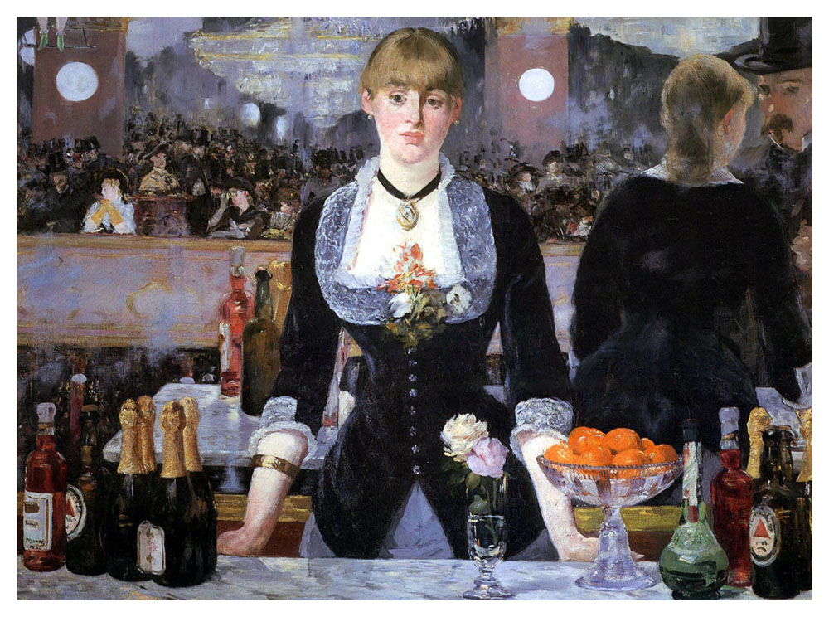
Using the elements of art, formulate a short analysis on the following image.

Slide 4
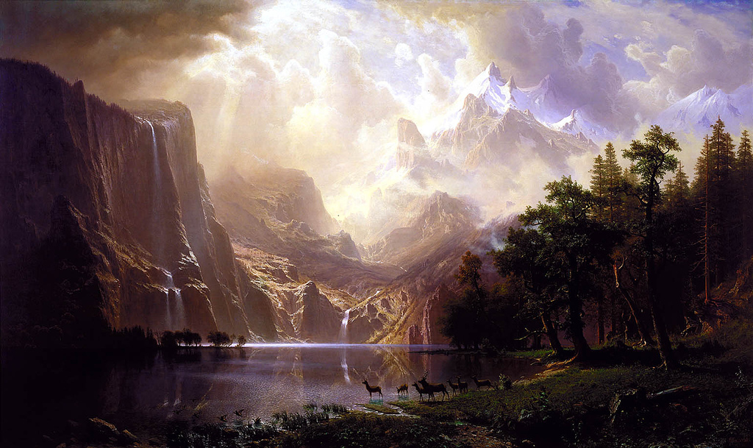
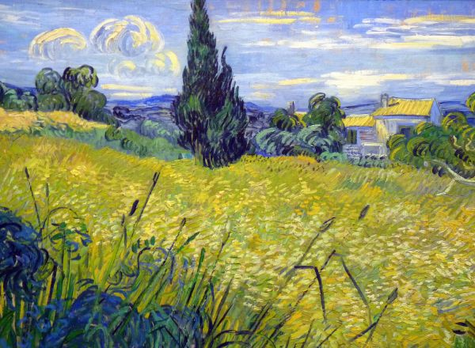
Compare and contrast the two works below using the elements of art.

