Slide 1
African Art

Slide 2
Vocabulary
Adobe
Aka
Bieri
Bundu
Cire Perdue
Fetish
Ikenga
Lukasa
Mblo
Ndop
Nkisi n’kondi
Pwo
Scarification
Torons

Slide 3
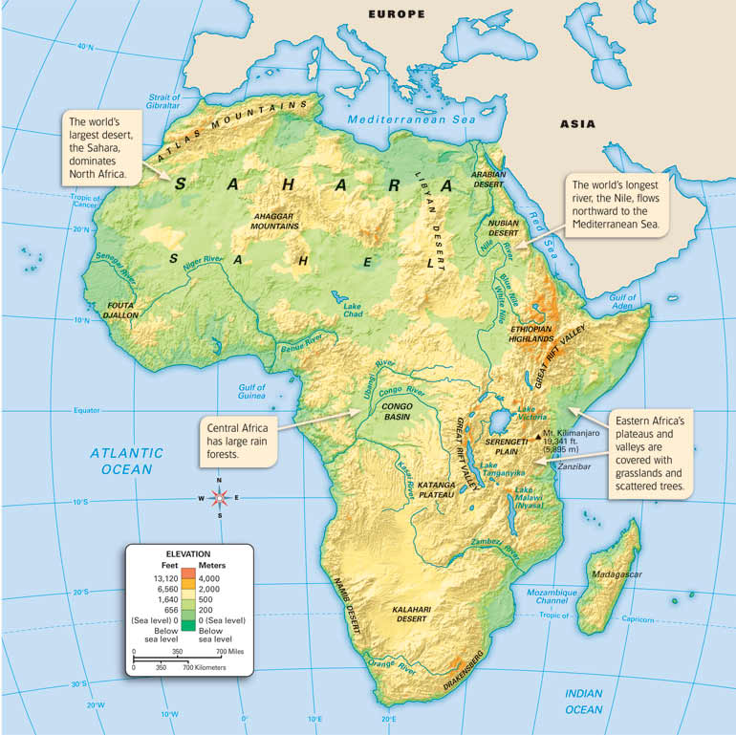

Slide 4
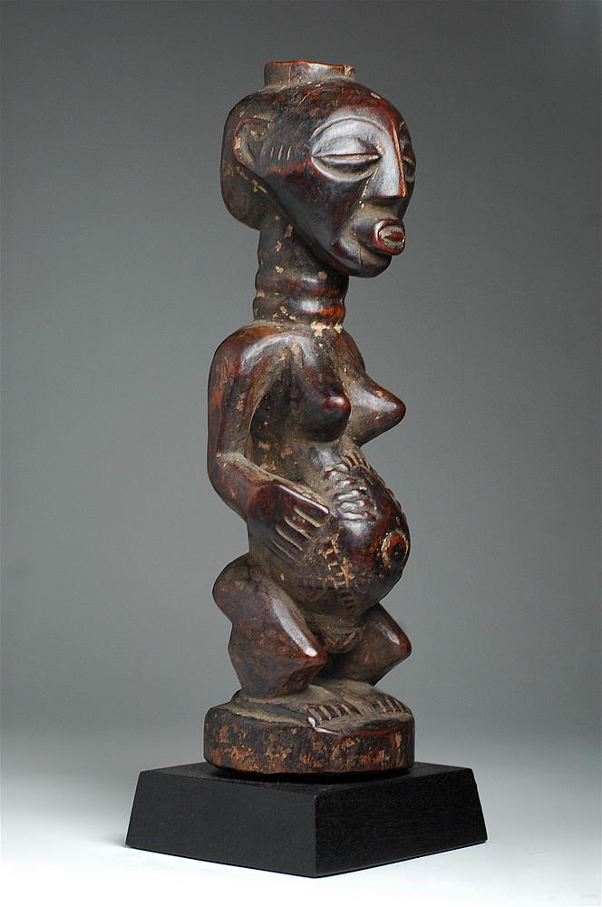
Historical Background
Despite vastness of African continent, artwork share similarities in methods of creation and common beliefs although strong cultural traditions with a wide variety of artistic expression exists
Belief that ancestors never die and can be addressed→sense of family and respect for elders (key component of African culture)
Many representations of family ancestors, carved to venerate their spirits
Fertility both of the land and of the individual is important
Spirits associated with forests or natural phenomena are respected and worshipped
Sculptures of suckling mothers are extremely common (implies that everyone suckles from the breast of God)
Luba / Songye Female Figure
Ethnic group : Luba, Songye
Country of origin : D.R. Congo, Angola
Material : Wood, beads
Approximate age : Early 20th Century
Dimensions : 11 in

Slide 5
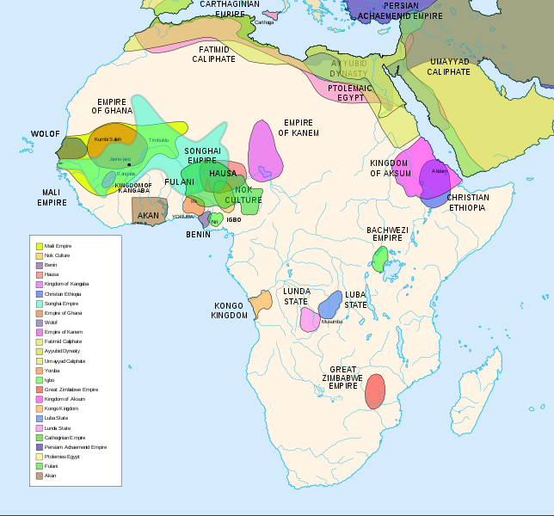
Historical Background continued…
Ancient civilizations in Carthage, Egypt, and Nubia dominated politics in North Africa centuries before empires developed in sub-Saharan Africa—or the rest of the world
Many African kingdoms come and go with regularity; more populous and dominant peoples occupy wide swaths of territory
Strong indigenous states were established in the Christian Aksum (Ethiopia) in the 4th century, and in the Lube Empire (central Africa) beginning in the 15th century. In the 12th century, an important cultural center developed on the Zimbabwe plateau

Slide 6
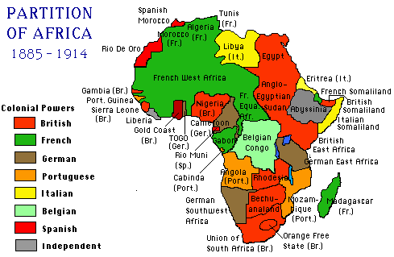
Historical Background continued…
Prior to foreign presence, struggles were largely internal due to natural barriers
Asians and Europeans presence complicates indigenous life beginning in the 15th century; generally outsiders restricted themselves to coastal areas until “The Scramble for Africa” in the late 1800s.
European control spanned less than a century—most states achieving independence in the 1960s, with Portuguese colonies receiving independence in the 1970s.

Slide 7
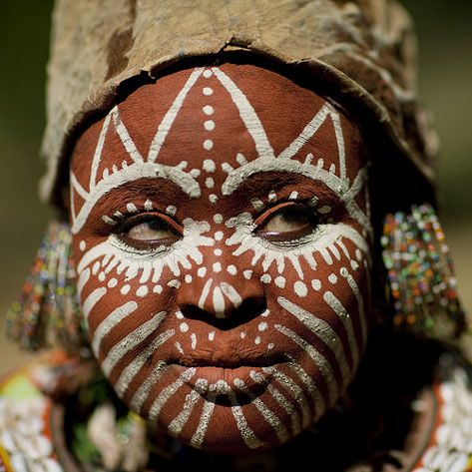
Historical Background continued
Oral tradition used to record history
Objects are unsigned and undated
Artists become famous within their own communities
Written records of artistic activity comes from Europeans or Islamic expansion into Africa
Artists worked on commission, often living with the patron, until the work was complete
Artists workshops standard
Artistic guilds common
Generally, men are builders and carvers; women painted walls and created ceramics; both sexes engaged in weaving—the exception is in Sierra Leone and Liberia where women wear masks during coming of age ceremonies
Most collectables come from permanent agricultural settlements; nomads of Kenya and Tanzania are famous for body art
African art was imported into Europe during the Renaissance; acceptance of African art as “art” occurred during the 20th century

Slide 8
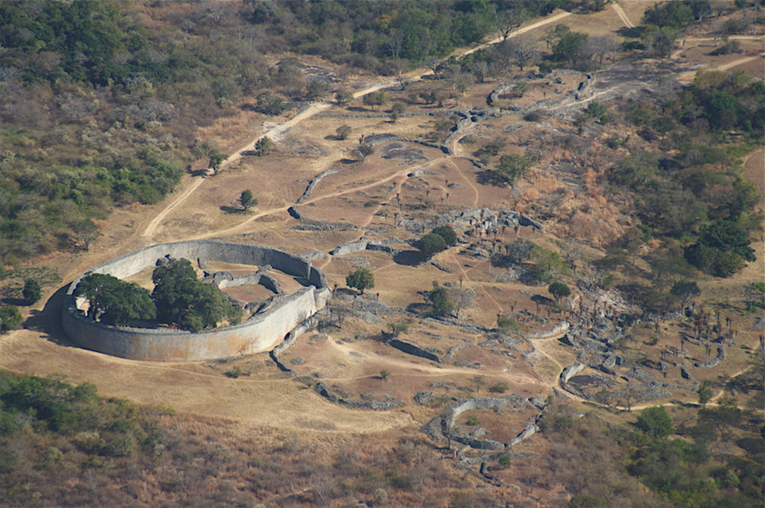
African Architecture
Built to be cool
Made of mudbrick walls and thatched roofs—problems during rainy season—horizontally placed timbers as maintenance ladders
Royal complex in Zimbabwe is the exception

Slide 9
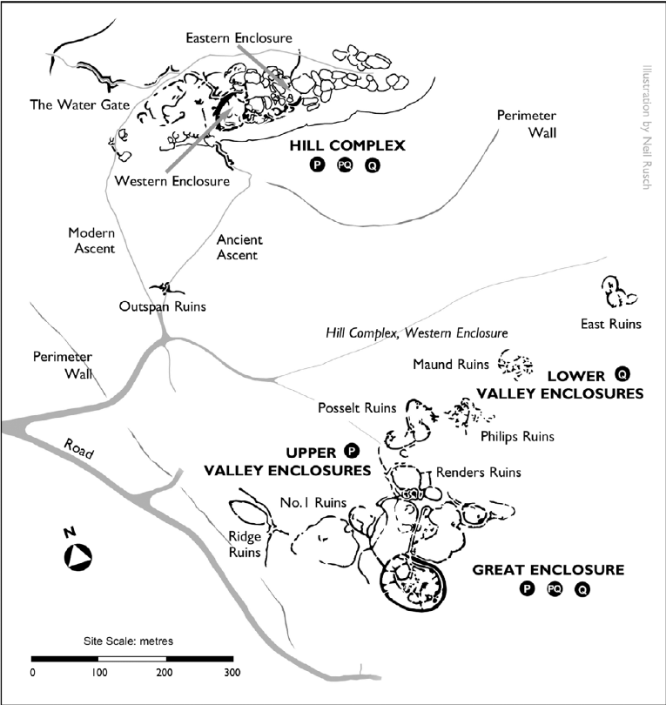
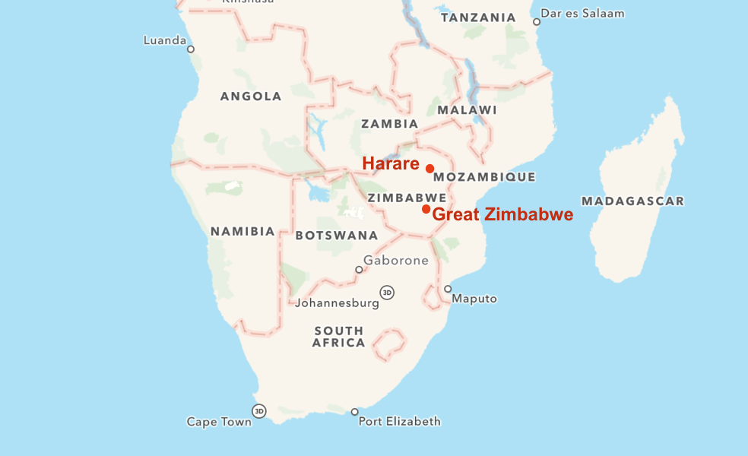

Slide 10
167. Conical tower and circular wall of Great Zimbabwe Southeastern Zimbabwe Shona peoples c. 1000-1400 CE Coursed granite blocks
Zimbabwe derives from the Shona term for “venerated houses” or “houses of stone”
Prosperous trading center and royal complex
Stone enclosure—probably a royal residence
Walls: 800 feet long, 32 feet tall, 17 feet thick at base

Slide 11
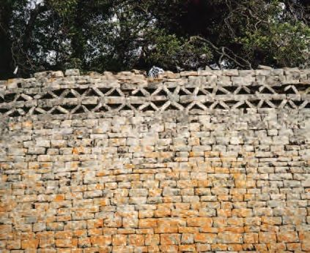
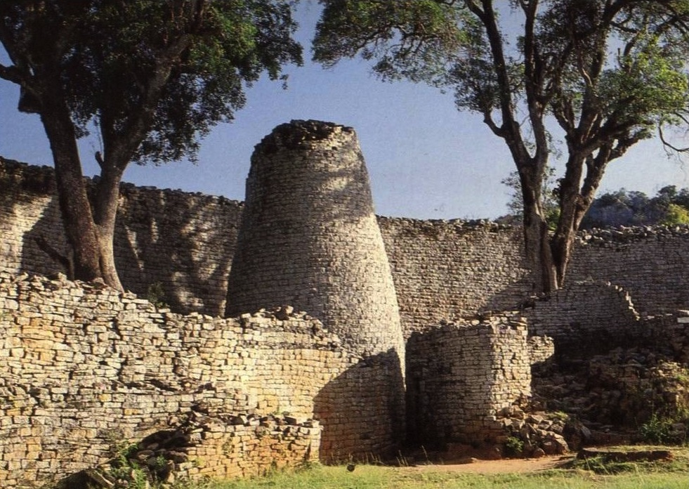
Conical towered modeled on traditional shapes of grain silos
This control over food symbolized a wealthy community with power and generosity
Walls slope inward toward the top; made of exfoliated granite
Internal and external passageways are narrow and long, forcing occupants to walk in a single file—paralleling experiences in the African bush
Tower resembles a granary—good harvest and prosperity
Video

Slide 12
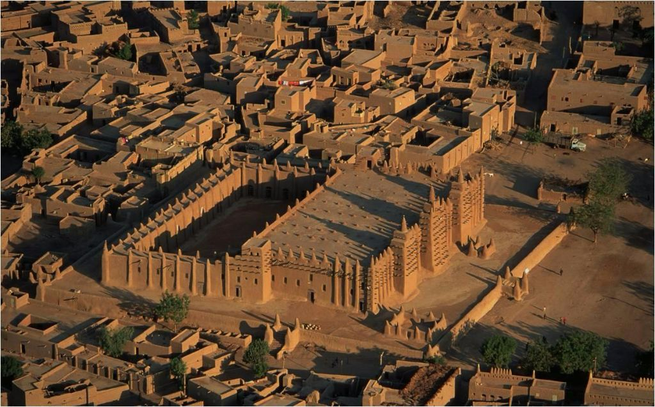
168. Great Mosque of Djenne Mali Founded c. 1200 CE, rebuilt 1906-1907 Adobe
Façade of three towers
The center tower is the mihrab
Crowning ornaments have ostrich eggs—symbols of fertility and purity
Torons-wooden beans projecting from the walls
Beams act as ladders for maintenance
Vertical fluting drains water off surfaces quickly
Made of adobe—a baked mixture of clay and straw
Largest mud-brick mosque in the world

Slide 13
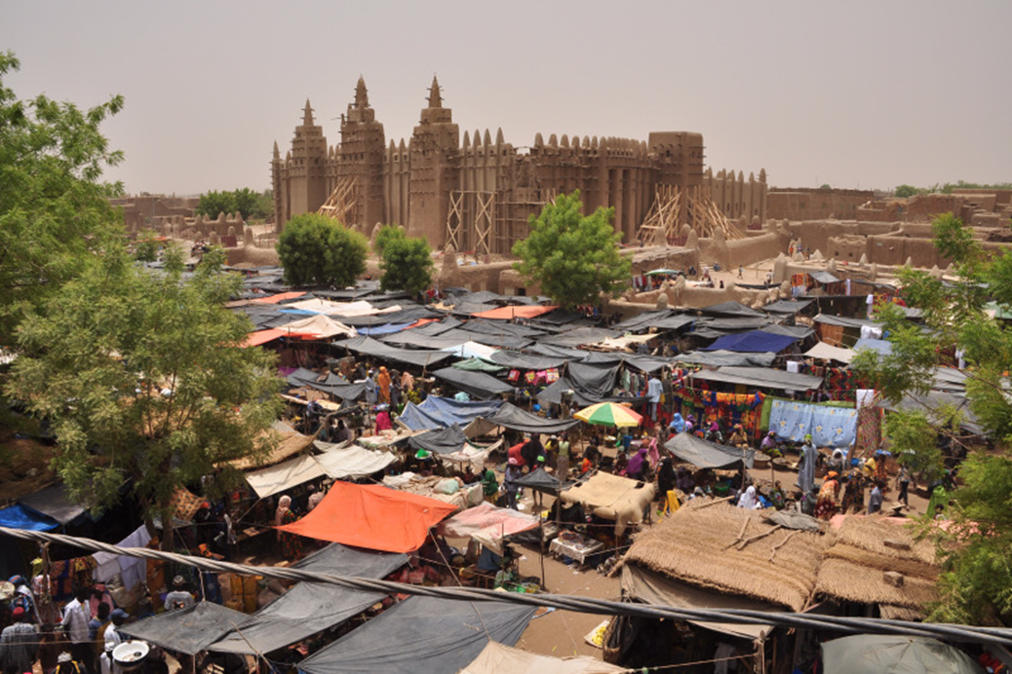
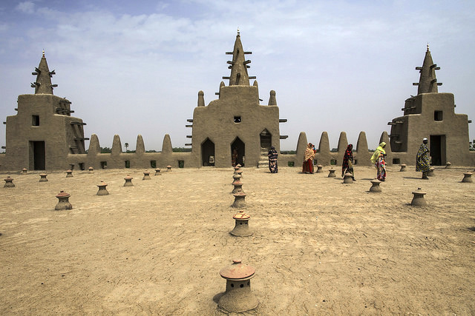
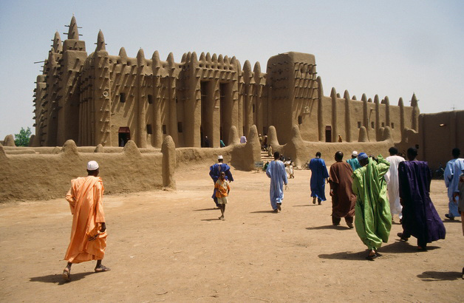
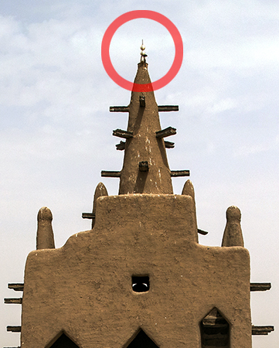

Slide 14
African Sculpture
Despite the vastness of the continent and cultures, there are many similarities:
Portable
Wood is a favored material
Ivory is a symbol of rank and prestige
Metal is a symbol of strength, durability, and reserved for royalty
Stone is rare
Figures are generally frontal, drawn in full face, details on the sides
Symmetry is used
No preliminary sketches
Stiffness; geometric in form; abstraction of figures
Heads are disproportionately large; bodies are immature and small; hands and feet are small; fingers are rare
Sexual characteristics are exaggerated
Multimedia is common—sculptured adored with feathers, beads, fabric, etc…
Important sculpture is never for decoration
Masks are part of a costume; each mask has a specific purpose and spirit; dancer connects with spirit world-transmitting messages to witnesses

Slide 15
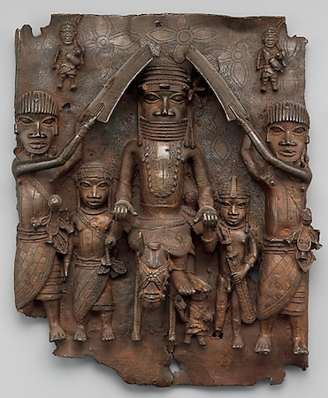
169. Wall plaque, from Oba’s palace Edo peoples, Benin (Nigeria) 16th century CE Cast brass
Benin-present day Nigeria
900 plaques produced, all between 16-18 inches
Decorated walls and wooden pillars with the royal palace in Benin
Depicts aspects of court life; tells the story of the royal lineage
Oba (king) believed to be the direct descendent of Oranmiyan, the founder of the dynasty.
Hierarchic scaling; symbols of high rank are emphasized (coral beaded regalia, only Oba can be sheilded)
Oba is stepping on fallen leader; Ceremonial scene at court
Emphasis on heads; bodies are small
Cire Perdue-lost wax process
High relief sculpture
Video
As power of Portuguese waned, so did Benin Empire. Palace seized by Britain in 1897—palace looted, city and palace burned, many killed

Slide 16
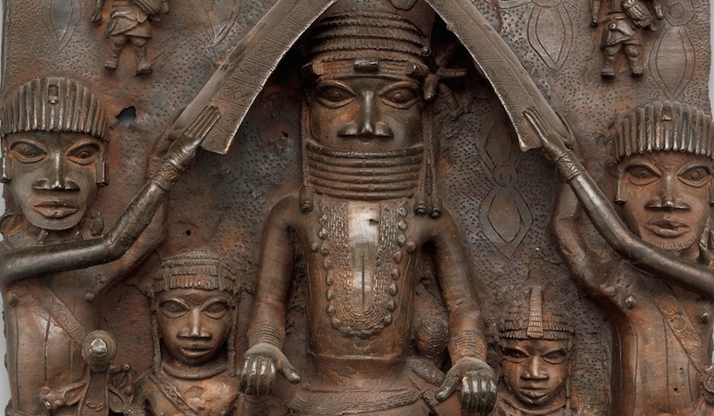
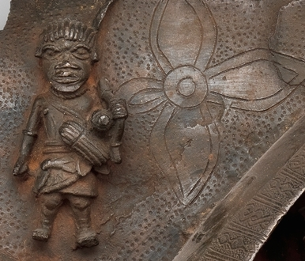
Rosette shapes-evidence of
contact with Europeans

Slide 17
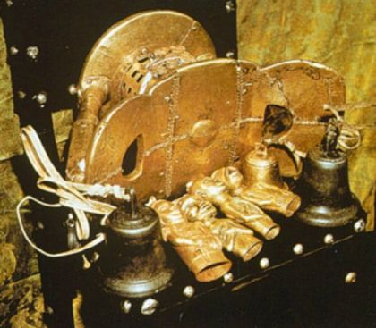
170. Sika dwa kofi (Golden Stool) Ashanti peoples (south central Ghana) c. 1700 CE Gold over wood and cast gold attachments
Symbol of Ashanti people in Ghana
Contains the soul of the nation
Never actually used as a stool; never allowed to touch the ground
The new king is raised over the stool; carried to the king on a pillow; he is the only person allowed to touch it
Only taken out on special occasions
Entire surface is inlaid with gold
Bells hang on the side to warm the king of danger
Replicas often used in ceremonies—each is different
Complicated history with British
Video

Slide 18
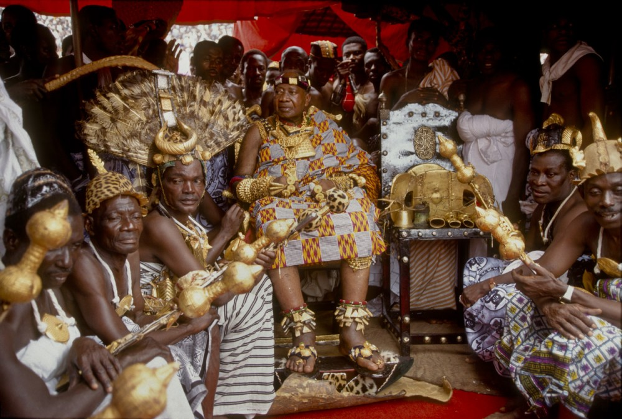
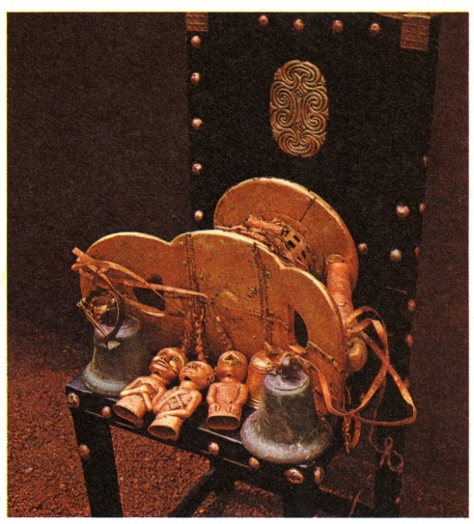

Slide 19
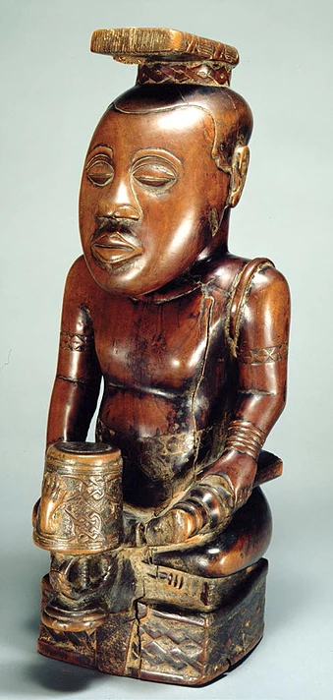
171. Ndop (portrait figure) of King Mishe miShyaang maMbul Kuba peoples (Democratic Republic of the Congo) c. 1760-1780 CE wood
Ndop figures are commemorative portraits of Kuba rulers, presented in an ideal state.
Not an actual depiction of a deceased king, but rather his spirit; made after his death
Each king is commemorated by symbols on the base of the figure—this king has a sword in his left hand, in a non-aggressive pose, with the handle facing out
One of the earliest existing African wood sculptures; oldest Ndop in existence
Rubbed with oil to protect them from insects
Acted as a surrogate for the king in his absence
Kept in the king’s shrine with other works called a set of “royal charms”
Royal regalia-bracelets, arm bands, belts. headdress
Characteristics of Ndop figures:
Cross-legged pose
Sits on a base
Face seems uninvolved; above mortal affairs
A peace knife in the left hand
1/3 ratio-head is seat of intelligence

Slide 20
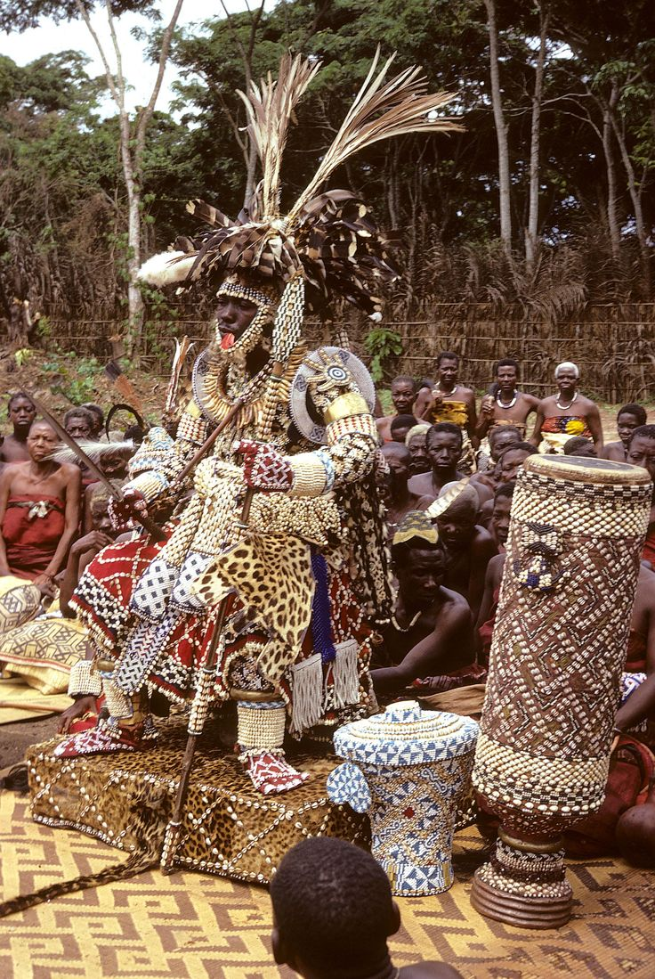
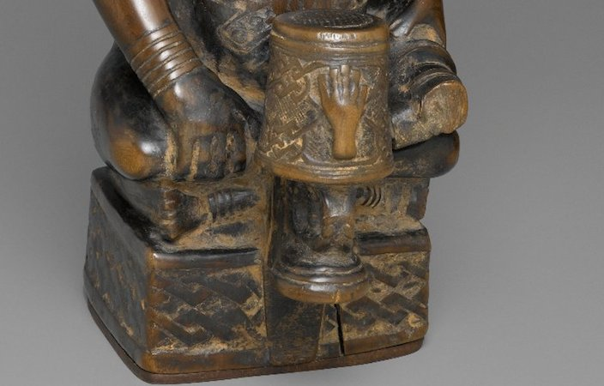

Slide 21
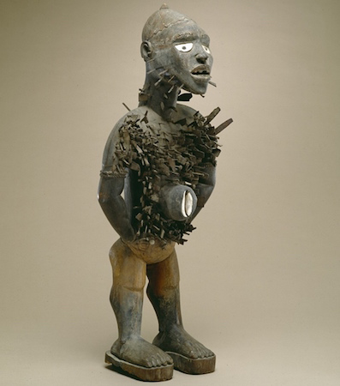
172. Power figure (Nkisi n’kondi) Kongo peoples (Democratic Republic of the Congo) c. late 19th century CE wood and metal
Nkisi n’kondi-Kongo power figure
Alert pose
Sacred medicines and divine protection are central beliefs to the Kongo
Spirits embedded in the images and can be called upon to bless or harm others; to give life or cause death
Create of a power figure is overseen by a nganga, or spiritual specialist, who activates the figures through chants, prayers, and preparation of specific substances

Slide 22
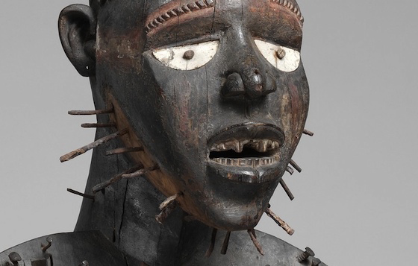
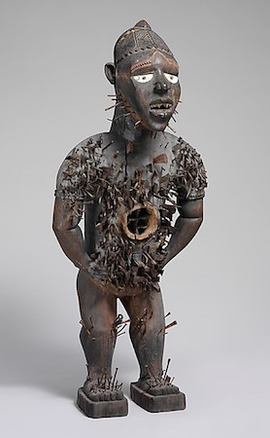
In order to activate the image into action, nails and blades are inserted into the work, or removed from it
Other insertions may include glass (represents other world in which spirits can look through and see enemies), seeds (to replicate itself), white soil (found near cemeteries and enlist support from spiritual realm), claws (to incite the spirit to grasp something), stones (to pelt enemies or for protection from enemies)
Prior to insertion, blades and nails are often licked, as to seal the intention—if the oath is broken the Nkisi n’kondi will seek destruction
Medical properties are inserted into the body cavity—thought to be a persons life or soul
Considered a fetish object—believed to possess magical powers—and confiscated by Christians; but eventually morphed into items such as voodoo dolls in the Americas.

Slide 23
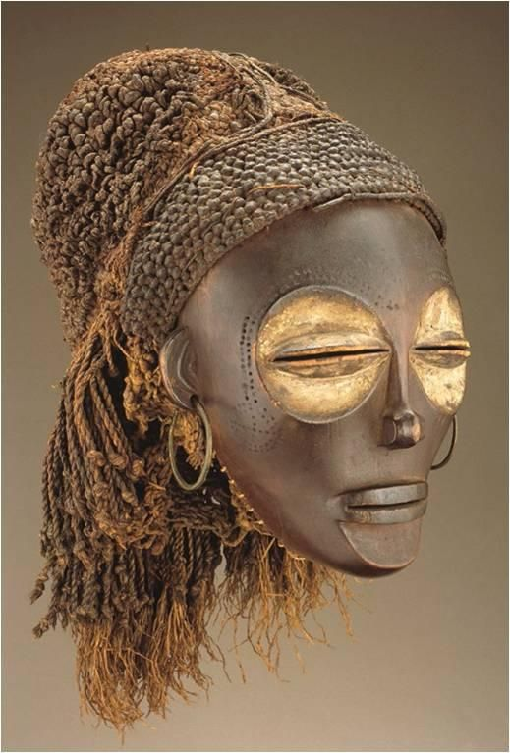
173. Female (Pwo) mask Chokwe peoples (Democratic Republic of the Congo) Late 19th to early 20th century CE wood, fiber, pigment, and metal
Female masks used by men during ritual dances
Dancers are fully covered and are dressed as a woman with braided hair and move around like women
Matriarchal society
Depicts female ancestors
Mask is discarded when no
t in use
Can be buried with the dancer
Characteristics:
Enlarged eye sockets
Pushed in chin
Slender nose
High forehead
Balanced features
Almost closed eyes
Video

Slide 24
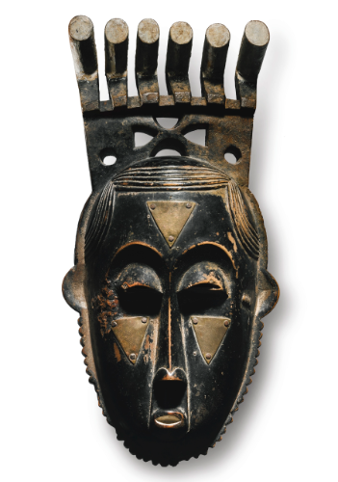
174. Portrait mask (Mblo) Baule peoples (Cote d’Ivoire) Early 20th century CE wood and pigment
Presented at Mblo performances in which an individual is honored by having ritual dances and tribute performed
The mask is a gift to the honoree that reflects an artistic double
The dancer who wears the mask and clothes of the honoree is accompanied by the honoree during the performance
The mask is an idealized representation of the person
Portraits of real people (even if commemorative) are rare in African art
Mblo portrait masks have broad foreheads, pronounced eye sockets, arched eyebrows and a column-shaped nose
Masks also have a quiet, introspective look with a peaceful face

Slide 25
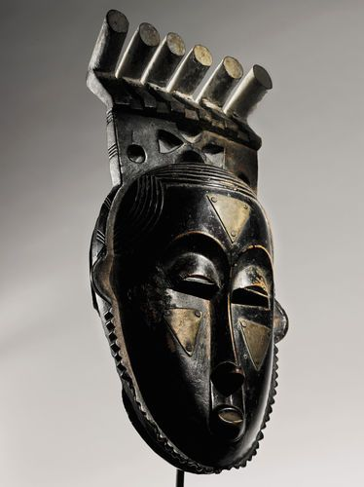
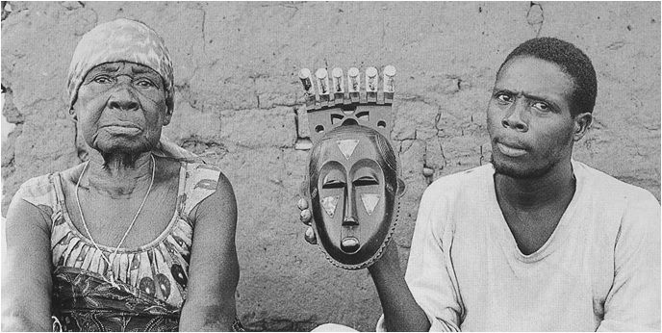

Slide 26
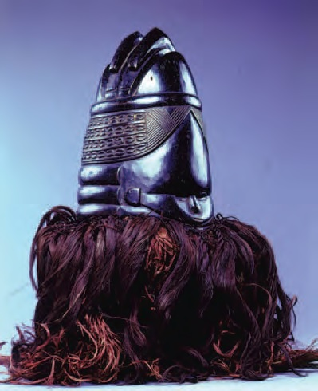
175. Bundu mask Sanda Society, Mende peoples (West African forests of Sierra Leone and Liberia) 19th to 20th century CE wood, cloth, and fiber
Only African wooden masks worn by women in the Sande society within Mende peoples. The Sande society is a group of women who prepare girls for adulthood and their role in society.
Idealized female beauty
Elaborate hairstyle symbolizes wealth—worn by women of status
Large forehead, small slit eyes, tight-lipped mouth (symbolizes secrets must not be revealed), the rings around the neck (concentric waves in which Sowei breaks through the surface),
During the mask ceremony a costumed woman wears a black gown made of raffia that hides the body with the mask. The mask rests on top of the head, head is not placed inside the mask. She is costumed as Sowei, the water spirit.
Coated with palm oil for sheen.
Black color symbolizes water, coolness, and humanity.
Individuality on each mask.
Video

Slide 27
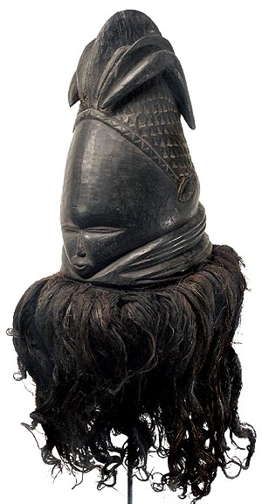
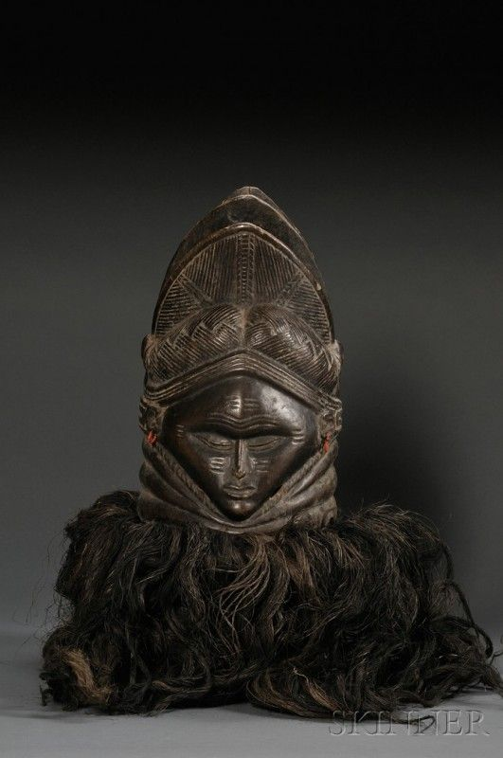
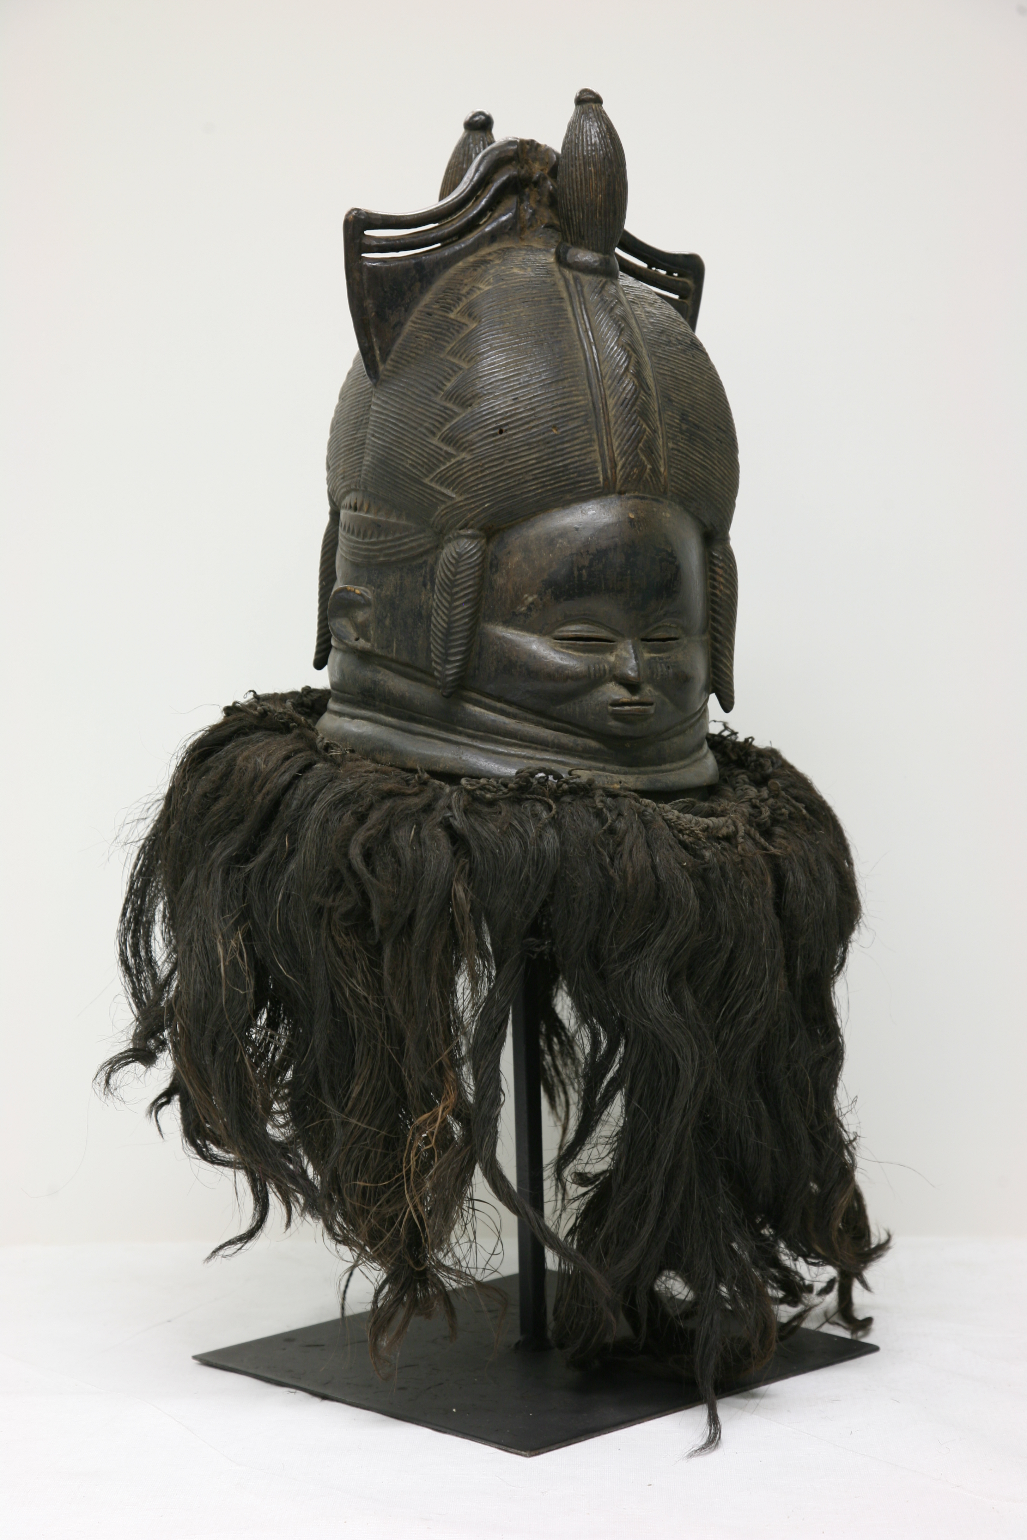

Slide 28
176. Ikenga (shrine figure) Igbo peoples (Nigeria) c. 19th to 20th century CE wood
Ikenga means “strong right arm”, this physical prowess
Honors the right hand, which holds tools or weapons, makes sacrifices, conducts rituals, and alerts to speak at public forums
Traditional masculine associations of strength and potency
Carved from hardwoods—considered masculine
Tells of the owners morality, prosperity, achievements, genealogy, social rank
It is a personal god of achievement and success
Required blessing before use
Large horns symbolize power
As a man achieves more success he might commission a larger, more elaborate Ikenga
It is maintained in the man’s home, destroyed when the owner dies; another can reused it if not destroyed
Video

Slide 29
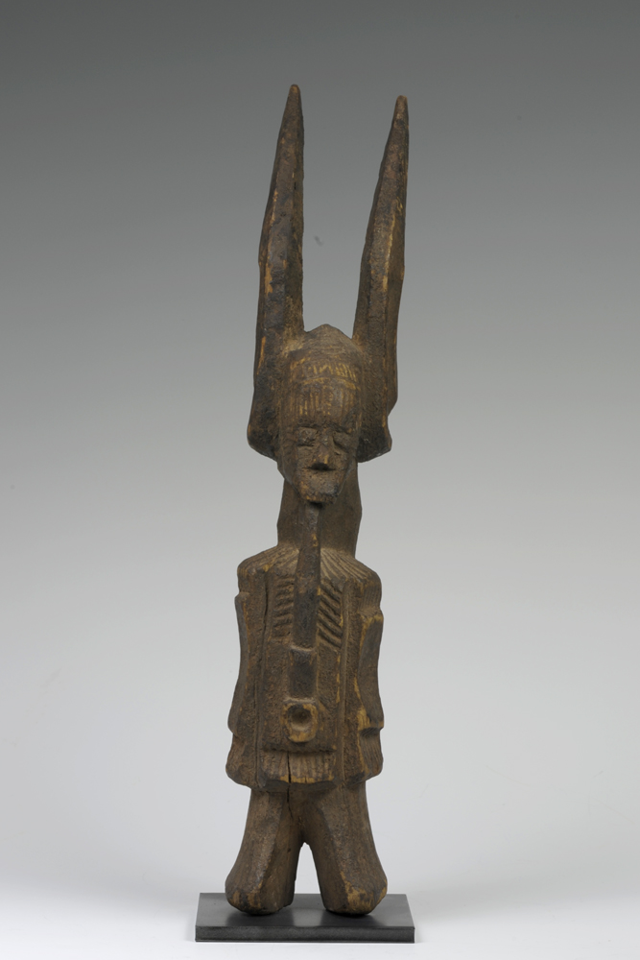
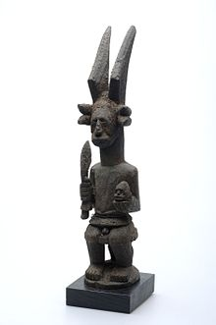
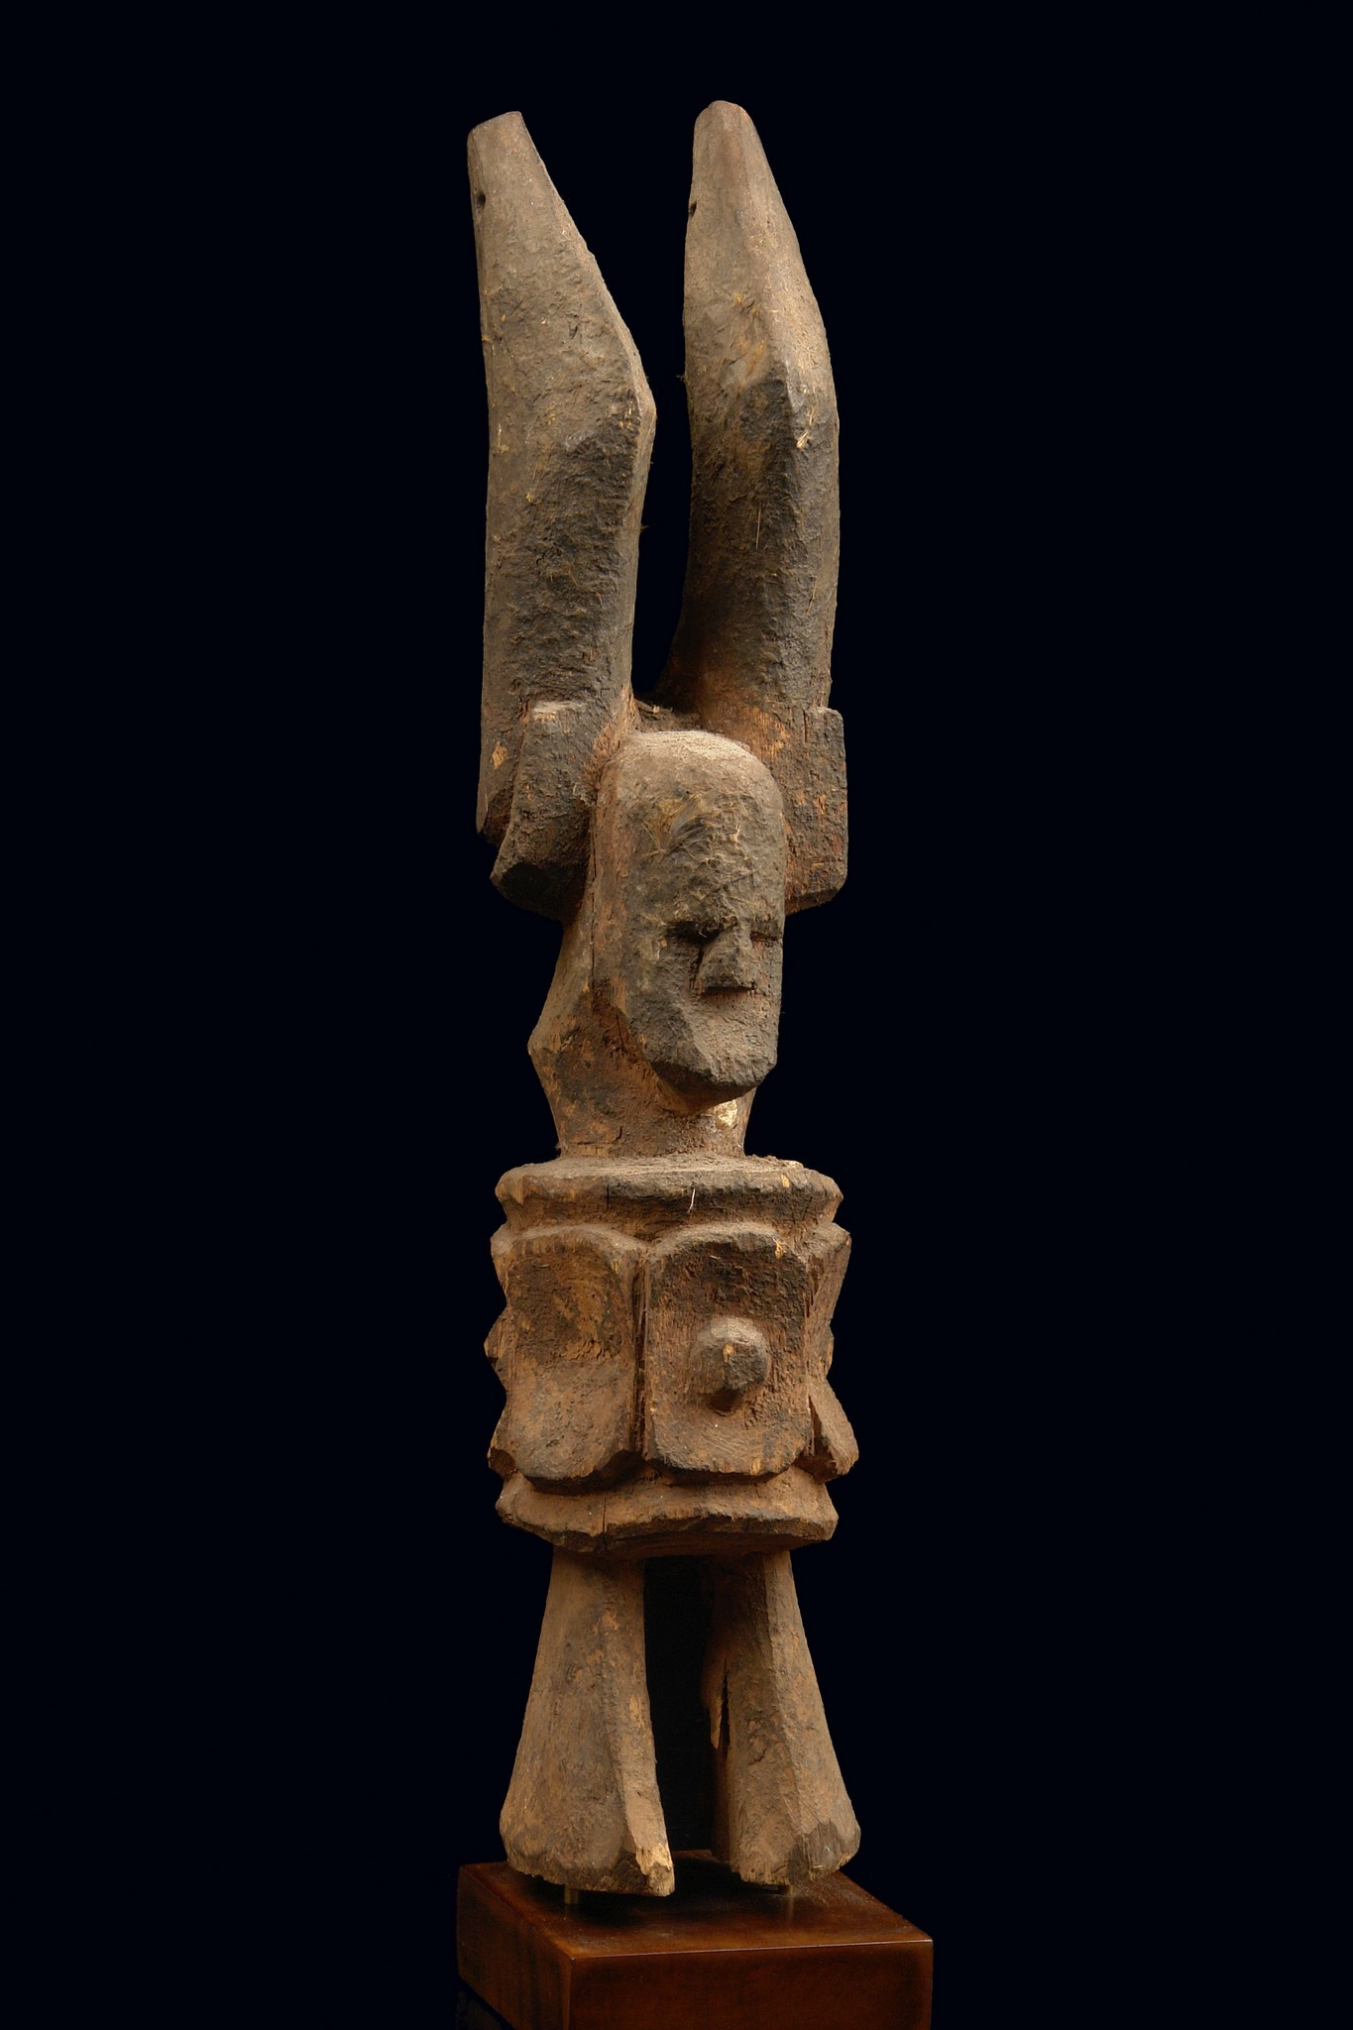

Slide 30
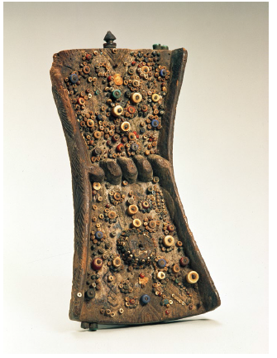
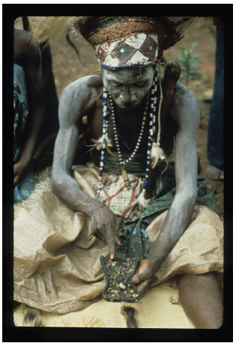
177. Lukasa (memory board) Mbudye Society, Luba peoples (Democratic Republic of the Congo) c. 19th to 20th century CE wood, beads, and metal
Lukasa, or memory board, helps the user remember key elements in a story (court ceremonies, migrations, heroes, kinship, genealogy, list of kings)
Carved from wood in an hourglass shape, then adored with shells, beads, and metal
Reader holds the board in left hand and traces the designs with the right index finger
The ability to read the board is limited to a few people
The back resembles a tortoise shell
Each board is unique and represents the divine revelations of a spirit medium expressed in sculptural form
The boards are controlled by the mbudye, a council of men and women who interpret the political and historical aspects of Luba society
Zoomorphic elements symbolize the crocodile, an animal that lives on both land and in water—duality a metaphor for Luba’s political organization which has two interdependent leaders

Slide 31
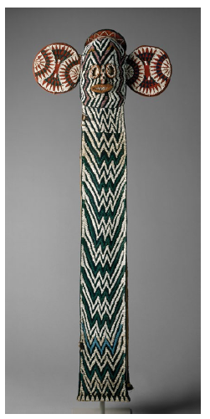
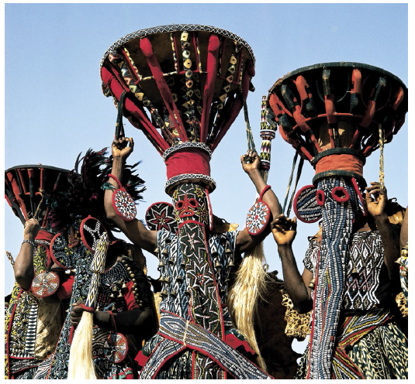
178. Aka elephant mask Bamileke (Cameroon, western grassfields region) c. 19th and 20th century CE wood, woven raffia, cloth, and beads
Only important people in society can own and wear an aka, or elephant mask
Work on important ceremonial occasions
Beadwork a symbol of power
Symbolized the features of an elephant
The mask fits over the head and two folds hang down in the front
Masked dancers go barefoot and dance to a drum and gong while waving spears and horsetails

Slide 32
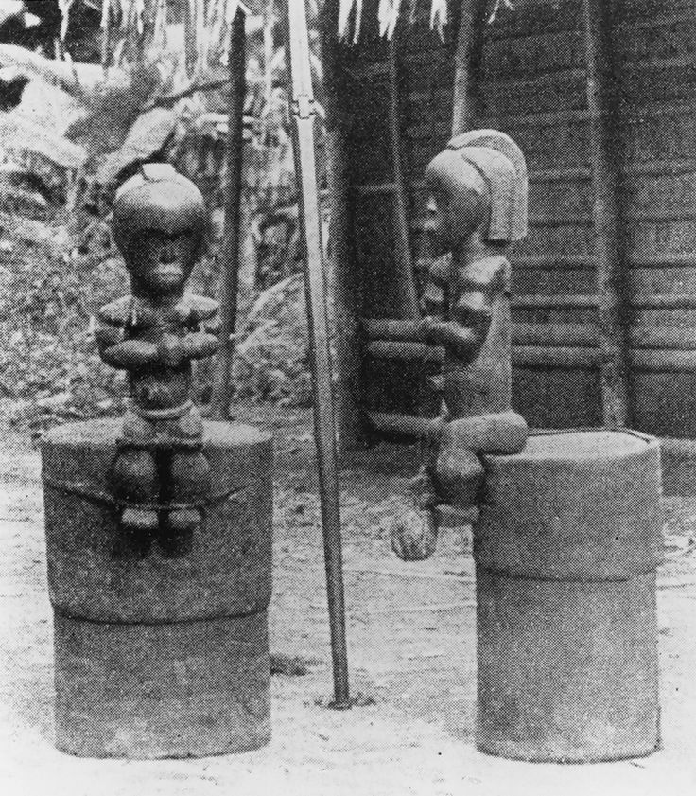
179. Reliquary figure (byeri) Fang peoples (southern Cameroon) c. 19th and 20th century CE wood
Figures placed on a top of cylinder-like containers made of bark that holds skulls and other bones of important clan leaders
Feet dangling over the rum in a gesture of protecting the contents
The reliquary figure guard the head box against the gaze of women or young boys
Bieri figures are composed of characteristics the Fang people place high value on: tranquility, introspection, vitality
Surfaces were ritually rubbed with oils to add luster and protect against insects
Prominent belly button and genitals emphasize life; the prayerful gesture and somber look emphasize death
Abstraction of human body an attraction for the early 20c artists
Video

Slide 33
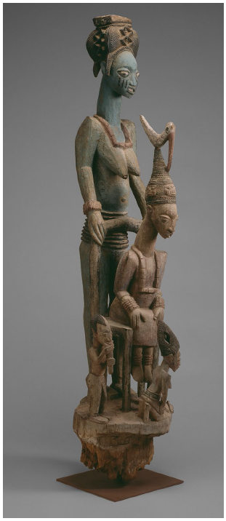
180. Veranda post of the enthroned king and senior wife (Opo Ogoga) Olowe of Ise (Yoruba peoples) c. 1910-1914 CE wood and pigment
Carved as posts for the rulers of the Yoruba Kingdom in Nigeria
One of four carved posts for the palace at Ikere
Negative space creates an openness in the composition
King is the focal point in the relationship between his figure and others represented in this post
Behind him his large scale senior wife supporting the throne; she crown the king during the coronation and protects him during his reign
Smaller figures—junior wife, flute player (Esu the trickster god), and a now missing fan bearer
Most posts were painted; traces of paint remain here
Video

Slide 34
